Slide 1

Chapter 6 - Writing Your Story
Imagining Life on the Steamboat

Slide 2

FOR THE TEACHER
Pre-reading class discussions
  Front-load Big Questions
Introduce students efpcs.org Chapter 6
Discuss character
Discuss plotlines or storyboarding
Discuss writing

Slide 3

Big Questions

Slide 4
Chapter 6 Big Questions
Where do WRITERS get their ideas about their stories?

Slide 5
Chapter 6 Big Questions
What kinds of things did people experience while on the steamboat?
What would you see in the water?
What would you see on the land as you passed by?
How many decks on the steamboat?
Who else traveled on the steamboat?

Slide 6
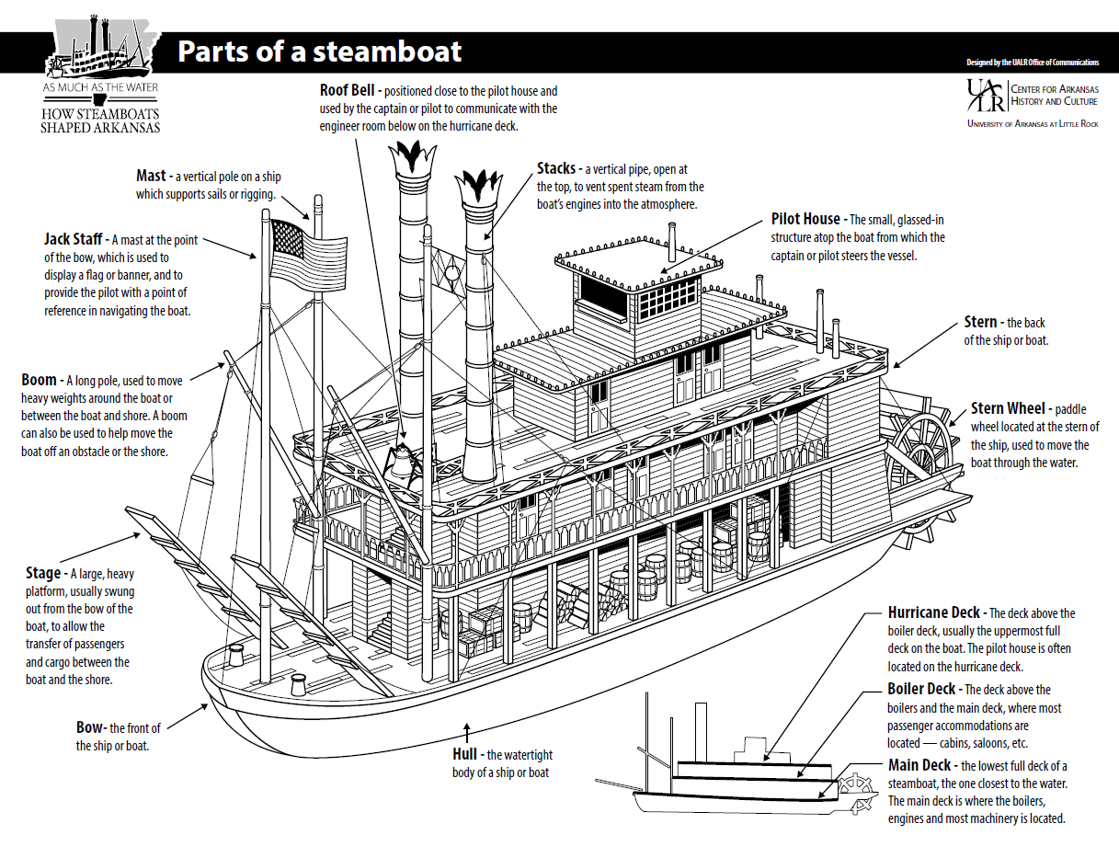

Slide 7
Chapter 6 Big Questions
What kinds of things did people experience while on the steamboat?
Were there animals on the steamboat?
Did storms occur while traveling?
What happened if someone fell overboard?
Did the steamboat stop at towns along the way?
Did the steamboats race on the river?

Slide 8
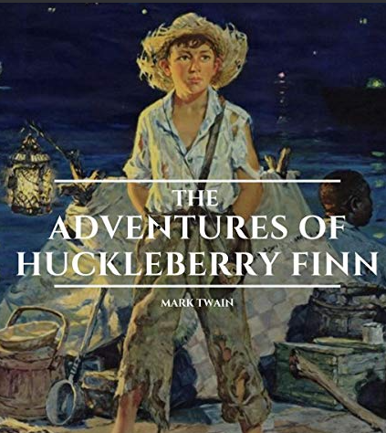
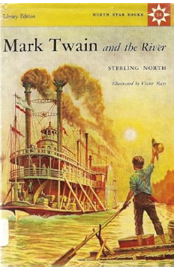
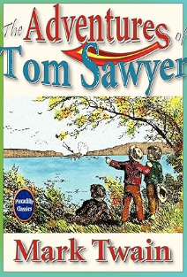
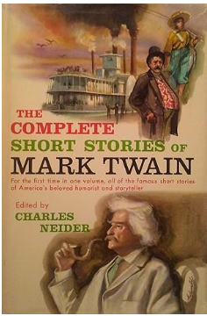
Chapter 6 Big Questions
Who is a famous writer about steamboats on the Mississippi River?

Slide 9
Chapter 6 Big Questions
What books have been written about steamboats?

Slide 10
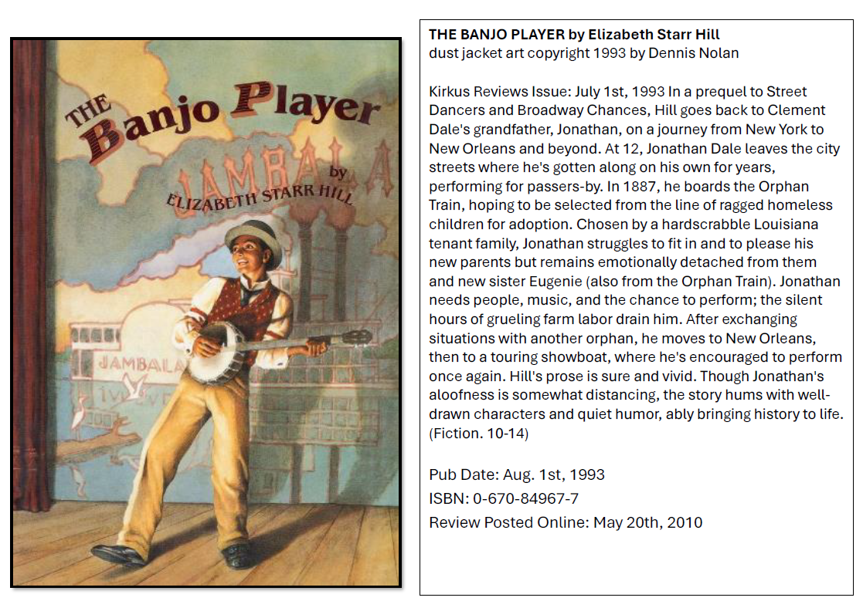
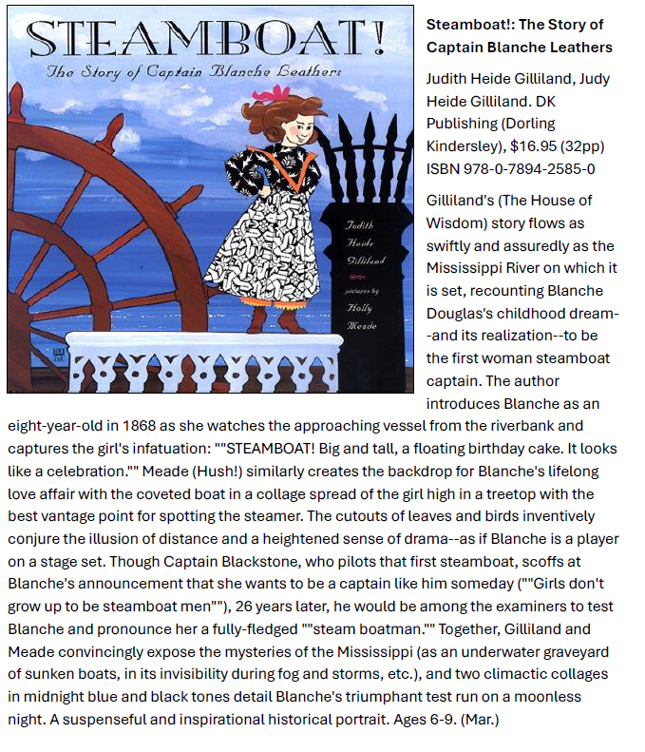
Chapter 6 Big Questions
What books have been written about steamboats?

Slide 11
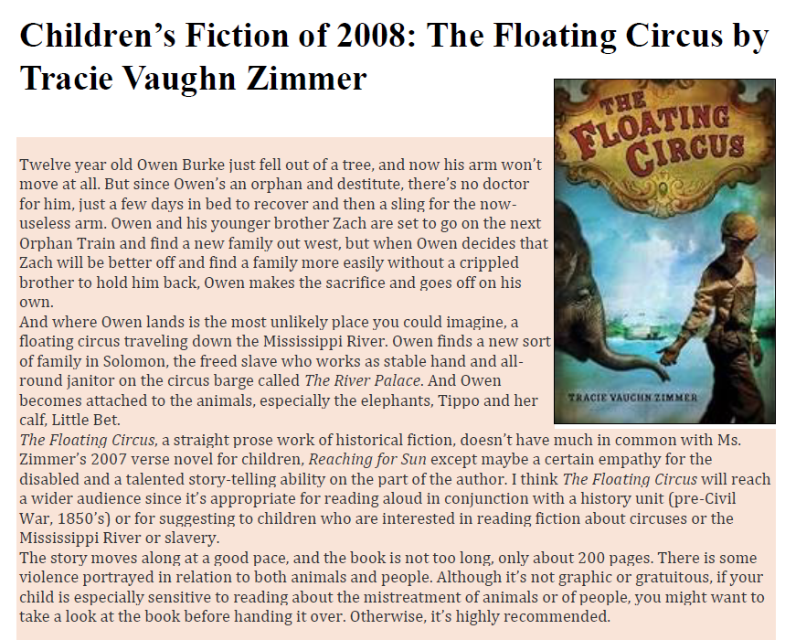
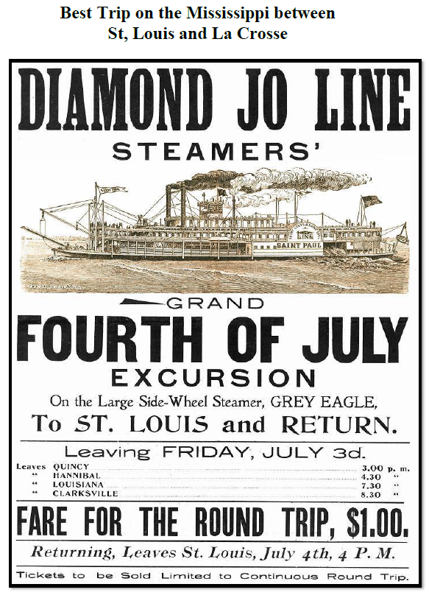
Chapter 6 Big Questions
What books have been written about steamboats?
This is an ad in the newspaper.

Slide 12
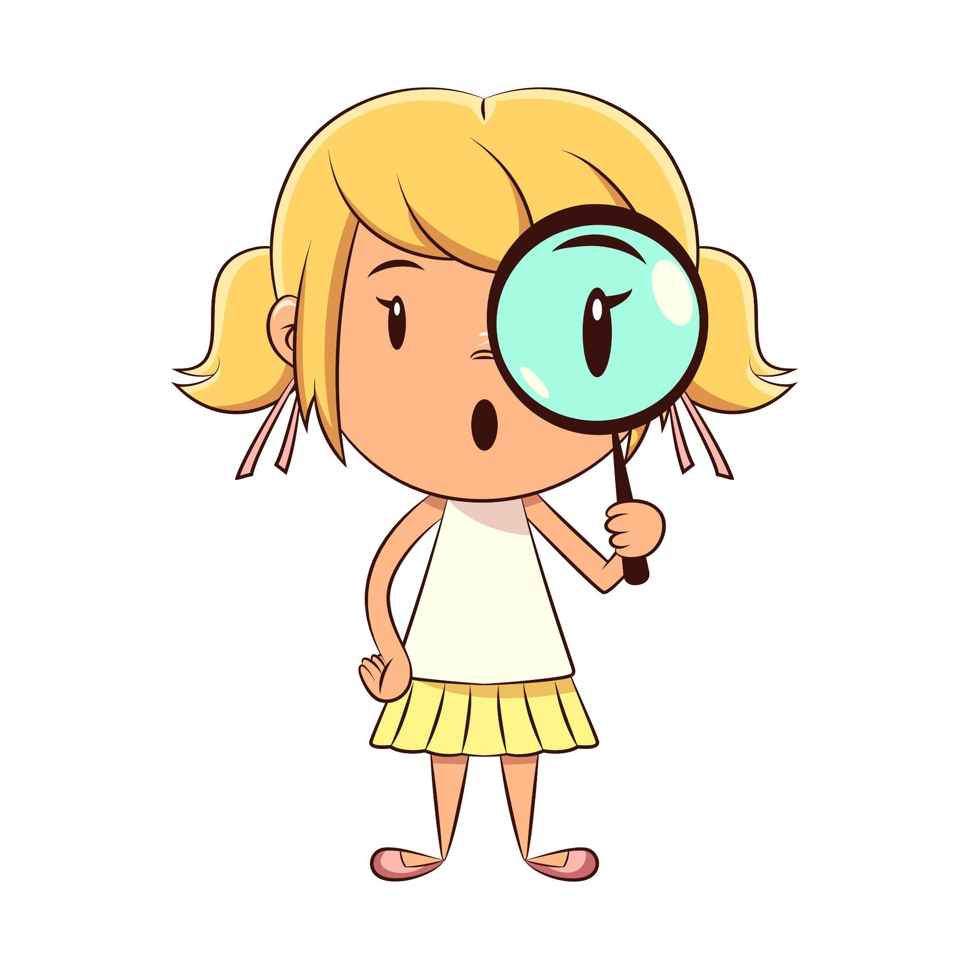
Characters
Who are you on the Steamboat in your story?
    Child
    Adult traveler
    Adult/Child Worker
Are you traveling or working with someone?
How do you and George become friends?

Slide 13

Summary
What is the summary of your story?
Storyboard your story

Slide 14
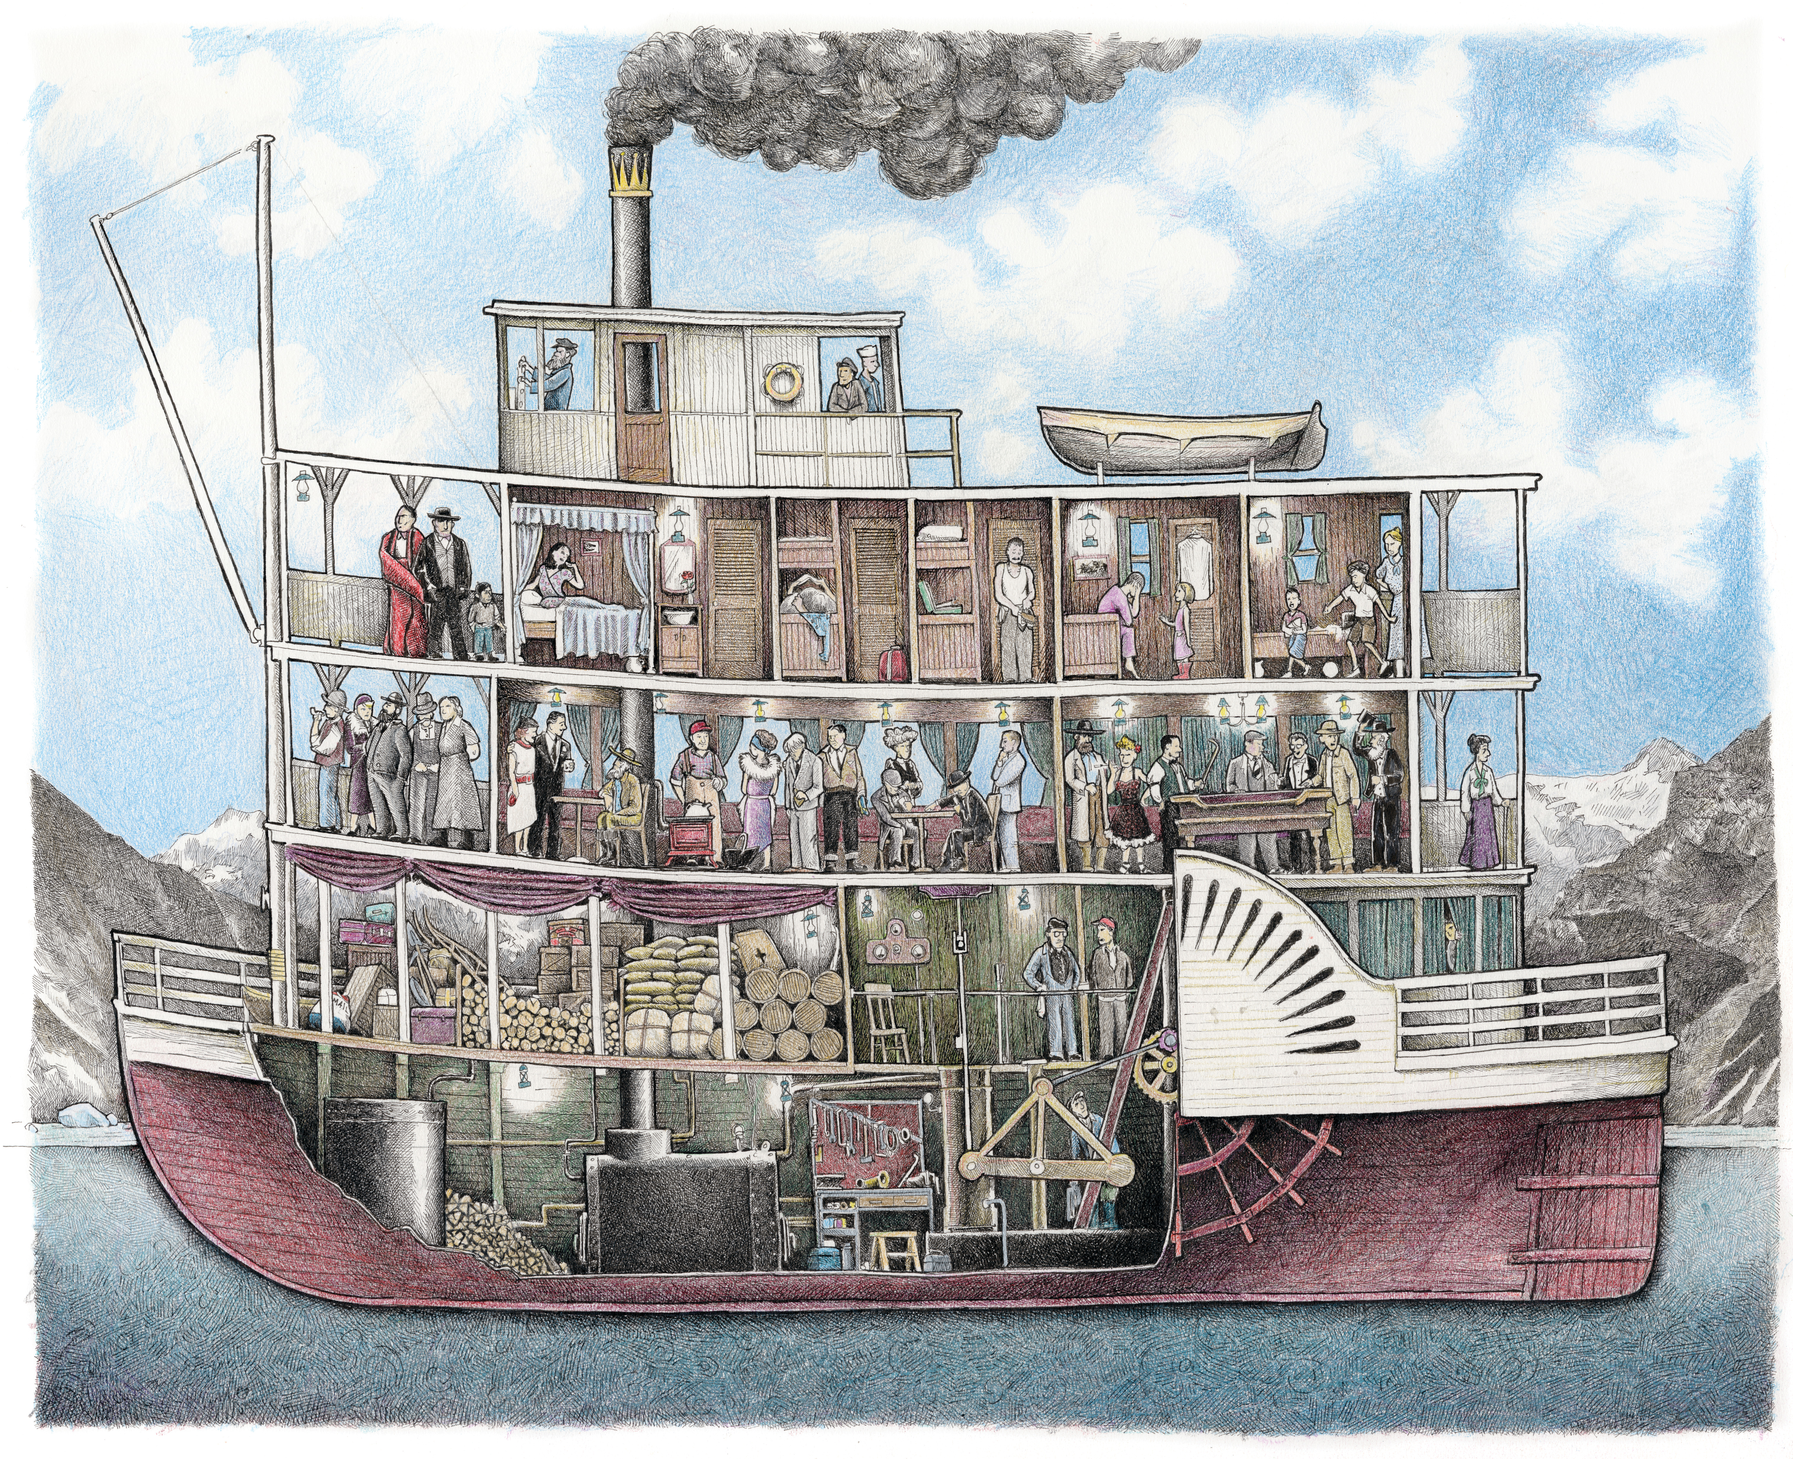
    Let’s
    Storyboard

Slide 15


Slide 16

