Slide 1
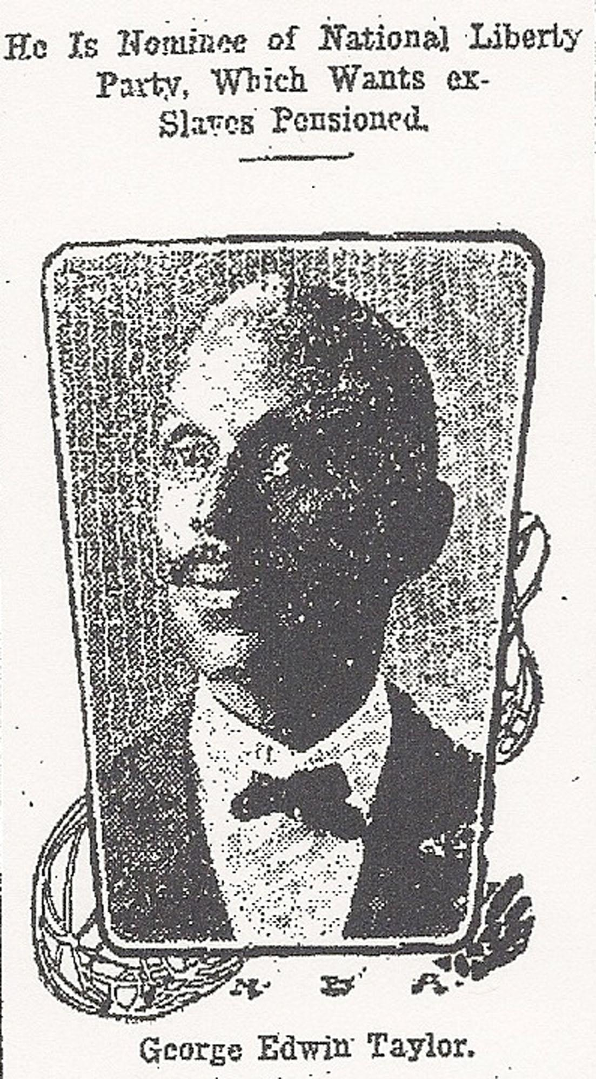
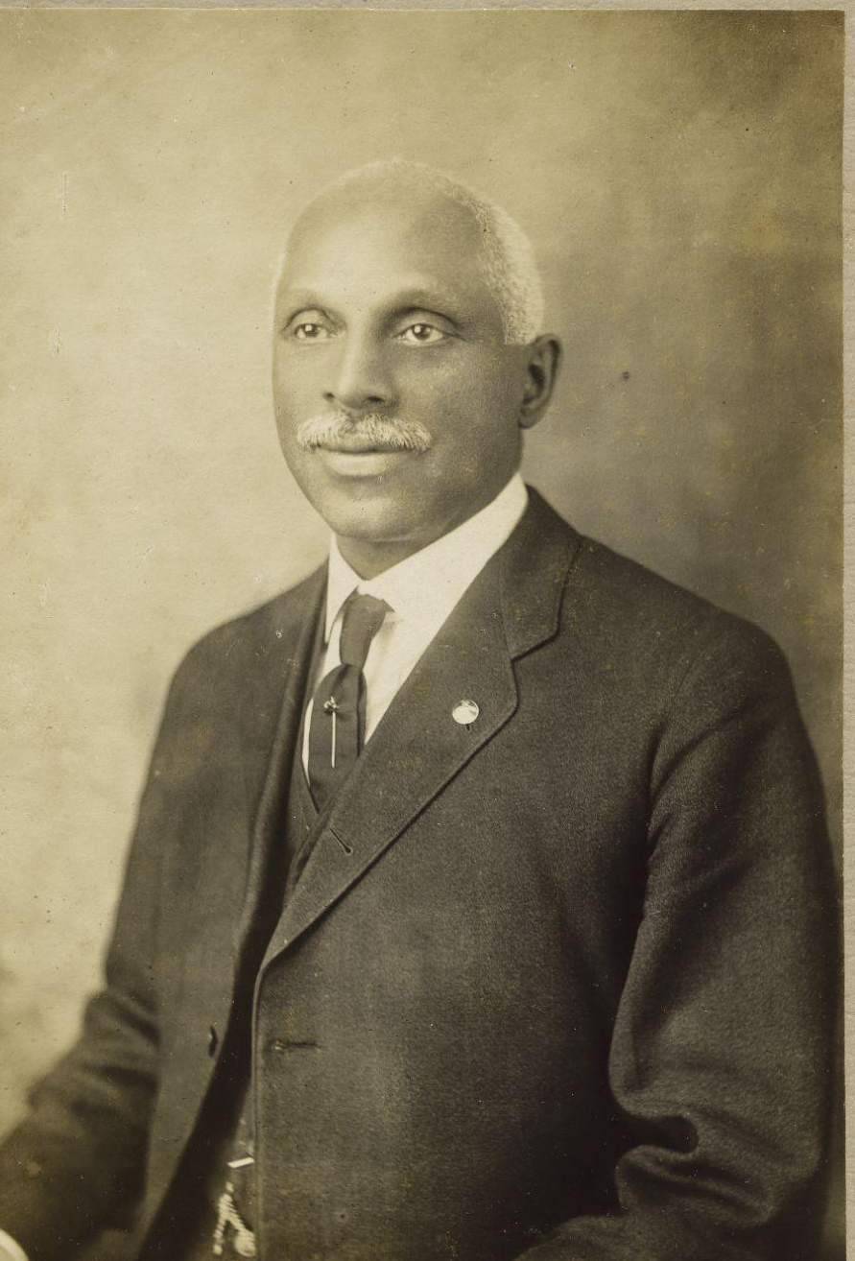
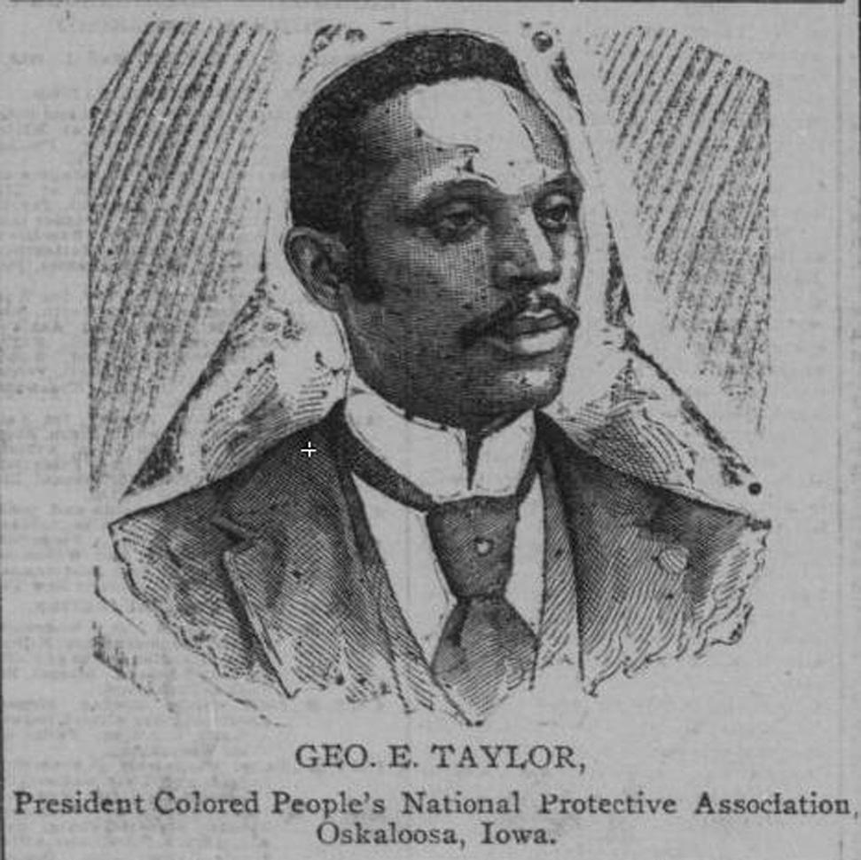

Chapter 9 Study Guide
Finding His
Purpose

Slide 2

FOR THE TEACHER
Pre-reading class discussions
  Front-load Big Questions
  Brainstorm vocabulary
Read chapter as a class or in small groups
Review main plot points
Step Away Activities
  Diary Entry #6
  If I Was President

Slide 3

Big Questions

Slide 4
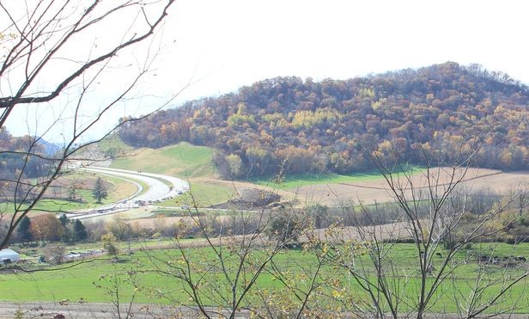
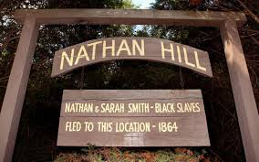
Chapter 9 Study Guide
What kind of chores or work do you think George did on the farm?
How do you think Nathan and Sarah Smith helped George break his “scrapping and scrounging” habits?
What rules did they put in place?
Do you think George broke any rules? What punishment?
How did George’s childhood influence the man he became as an adult?
After reading the chapter, use the above “Big Questions” in a class discussion.

Slide 5

Vocabulary

Slide 6

Chapter 9 Vocabulary
What do these mean?
Racial Segregation
Plessy v. Ferguson
Activist
Constitutional right
Pension

Slide 7
Chapter 9 Vocabulary
Racial Segregation: the separation of races; Black people had to use different services than White people, such as water fountains, pools, sections of movie theatres and buses
Plessy v. Ferguson: an important Supreme Court decision that made racial segregation legal; prior to this it was “tradition”
Activist: someone who fights for social change
Constitutional right: freedoms and rights guaranteed to all citizens of our country
Pension: regular payments to a person in retirement

Slide 8

Summary

Slide 9
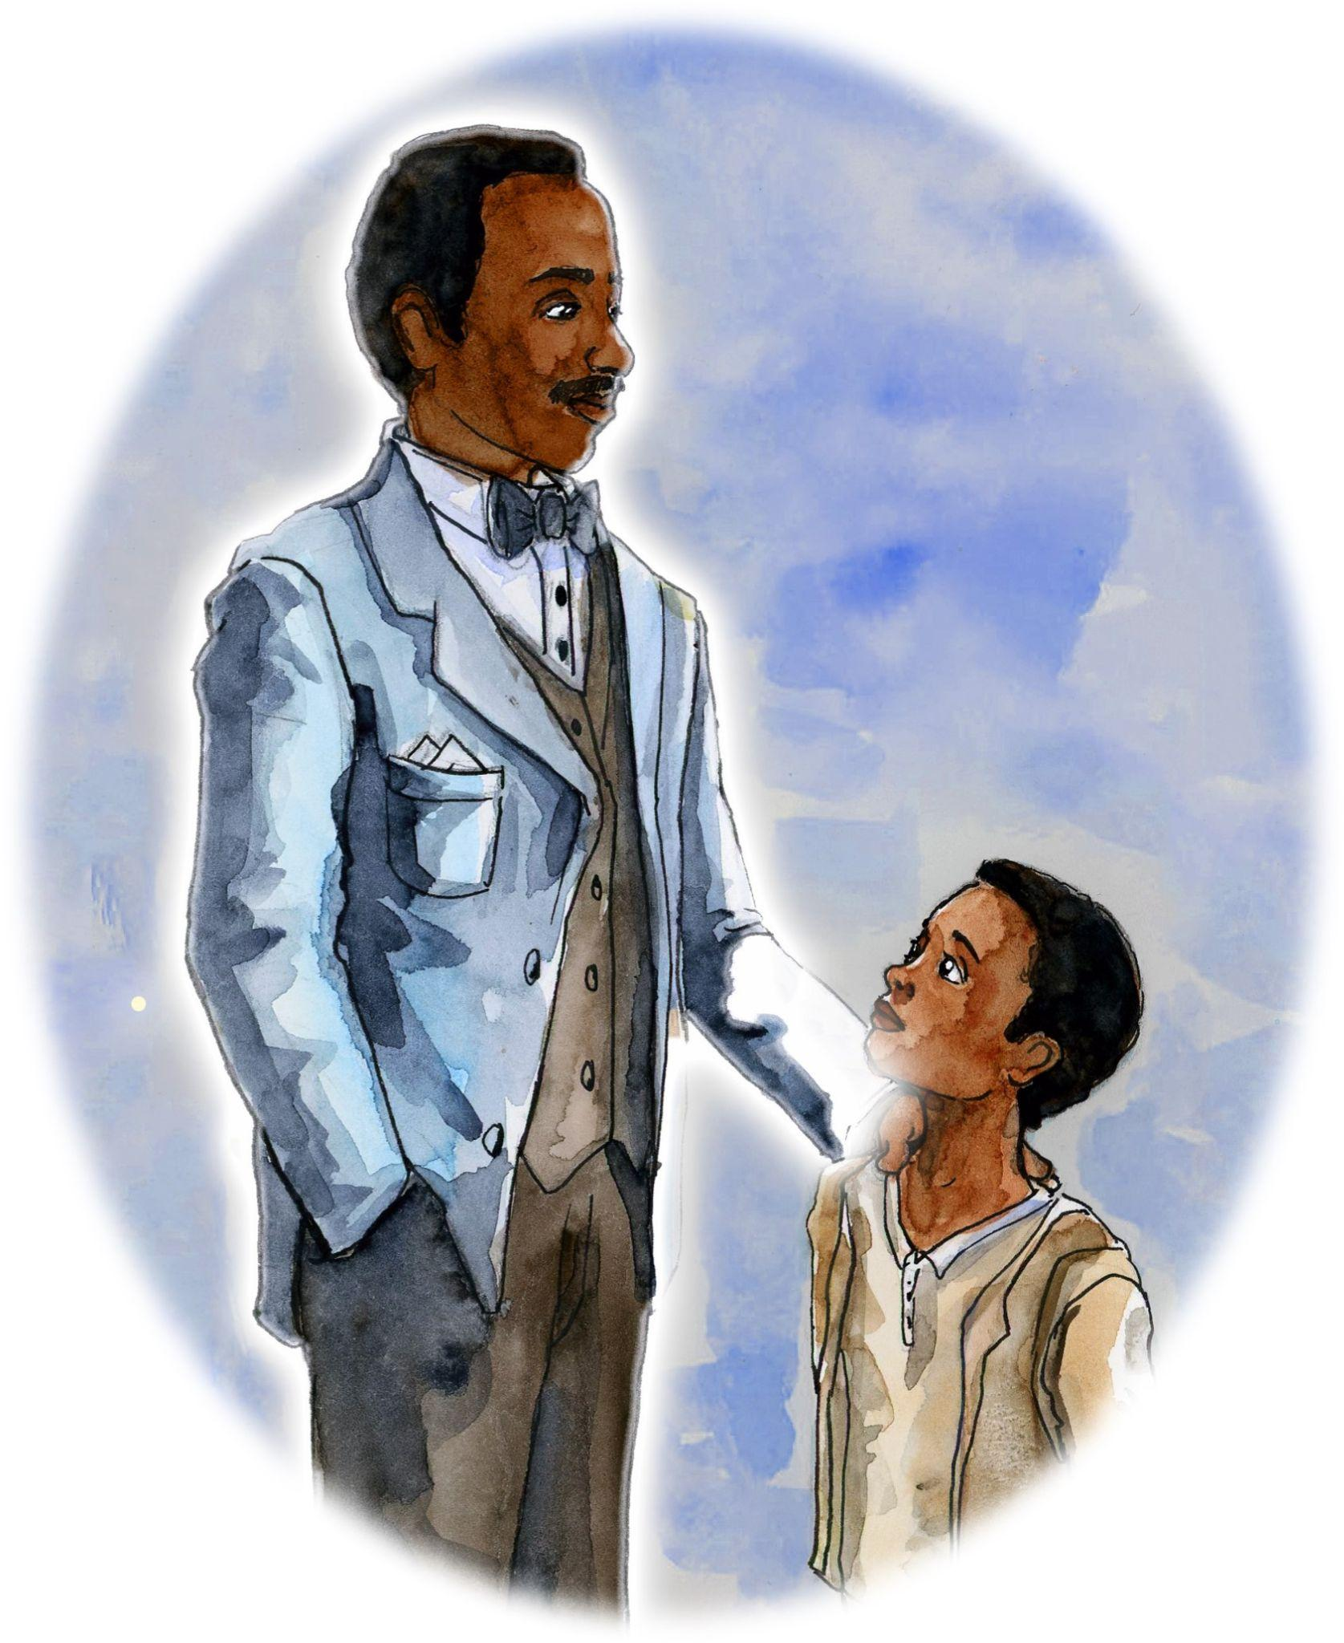
Chapter 9 Summary
The Professor reveals that Nathan Smith and
his wife, Sarah, “broke” George’s “scrapping
and scrounging” habits.
Professor imagines what Nathan Smith
may have been like.
The Smiths sent four of their boys to college,
including George.
After college, George worked for a newspaper in La Crosse, and eventually started his own newspaper, La Crosse Labor Advocate

Slide 10
Chapter 9 Summary
Nathan Smith inspired George to get involved
with politics, and George eventually became
a civil rights activist.
In 1904, George Edwin Taylor became the
first African American to run for President
of the United States.
Researchers discuss how George’s childhood
influenced his political beliefs, and how his growth was inspiring.

Slide 11

Step Away Activities

Slide 12
Chapter 9 Step Away Activities
Diary Entry #6: George’s First Day of College
If I Was President

Slide 13


Slide 14

