Slide 1
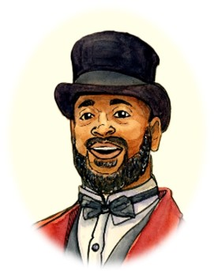

Chapter 8 Study Guide
The Professor’s Story

Slide 2

FOR THE TEACHER
Pre-reading class discussions
  Front-load Big Questions
  Brainstorm vocabulary
Introduce students to characters in the chapter
Read chapter as a class or in small groups
Review main plot points
Step Away Activities
  Diary Entry #5
  George’s Suitcase

Slide 3

Big Questions

Slide 4
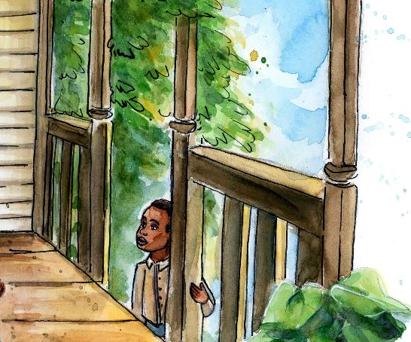
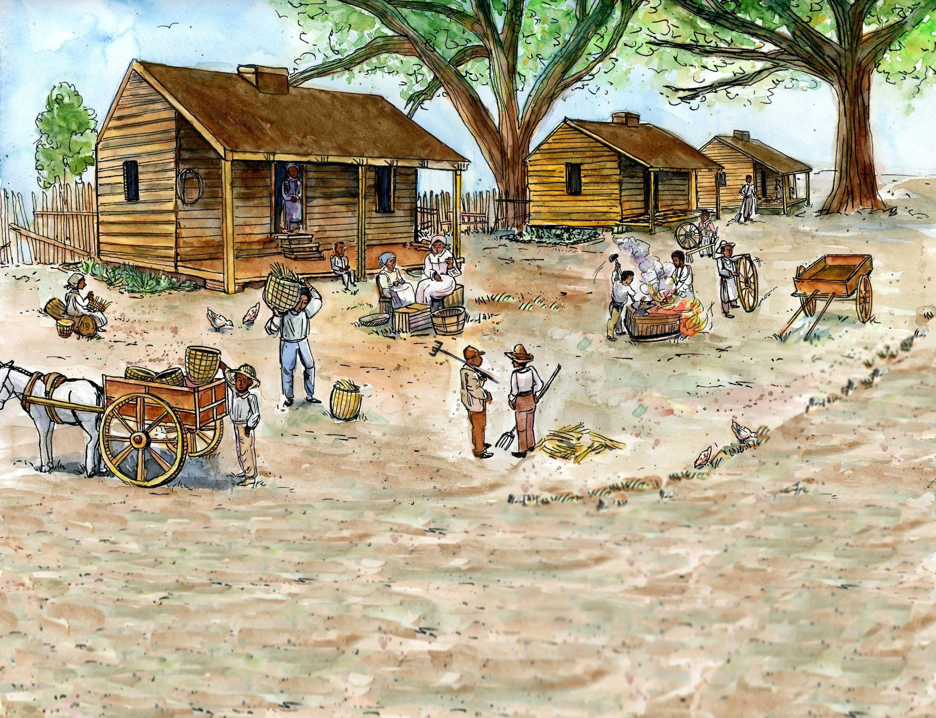
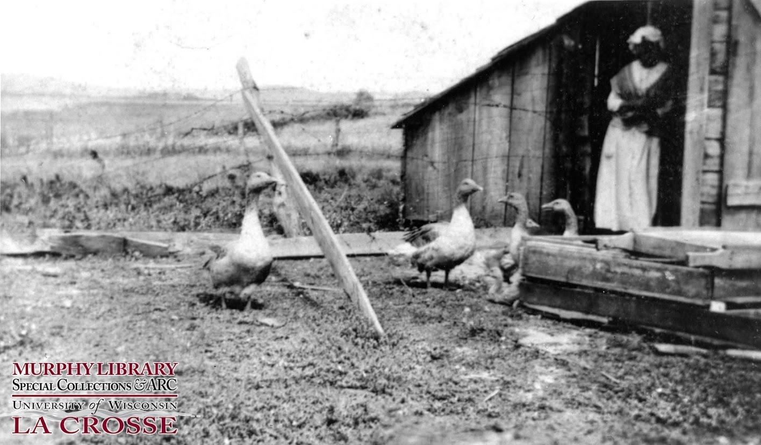
Chapter 8 Big Questions
Why did George have a hard time adjusting to life at the Southall’s
in the beginning?
Why would Nathan and Sarah Smith take in troubled boys like George?
Property
Verses
Freedom

Slide 5


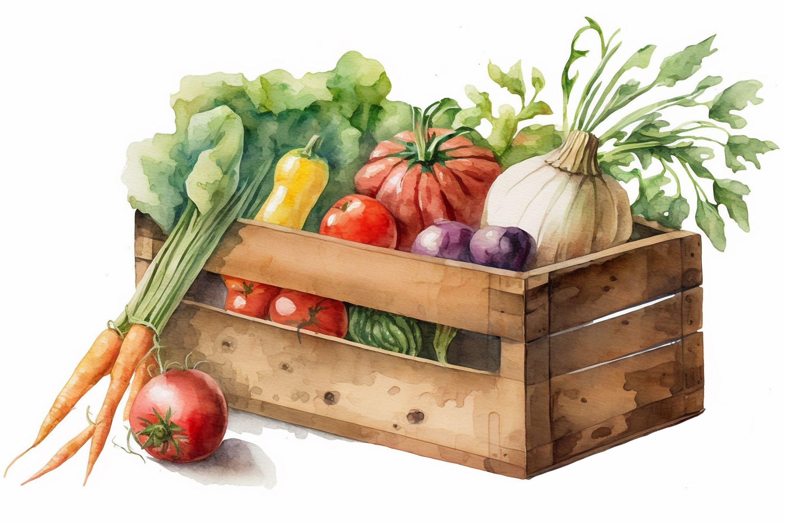
Chapter 8 Big Questions
What was the significance of Nathan Smith giving George lemon drop candies?
Why did George keep “scraping and scrounging” even though he had plenty in his life? How did it get him in trouble?
After reading the chapter, use the “Big Questions” in a class discussion.
What bad habit do you have and are too afraid of letting it go?

Slide 6

Vocabulary

Slide 7
Chapter 8 Vocabulary
What do these mean?
Debt
Buckboard wagon

Slide 8
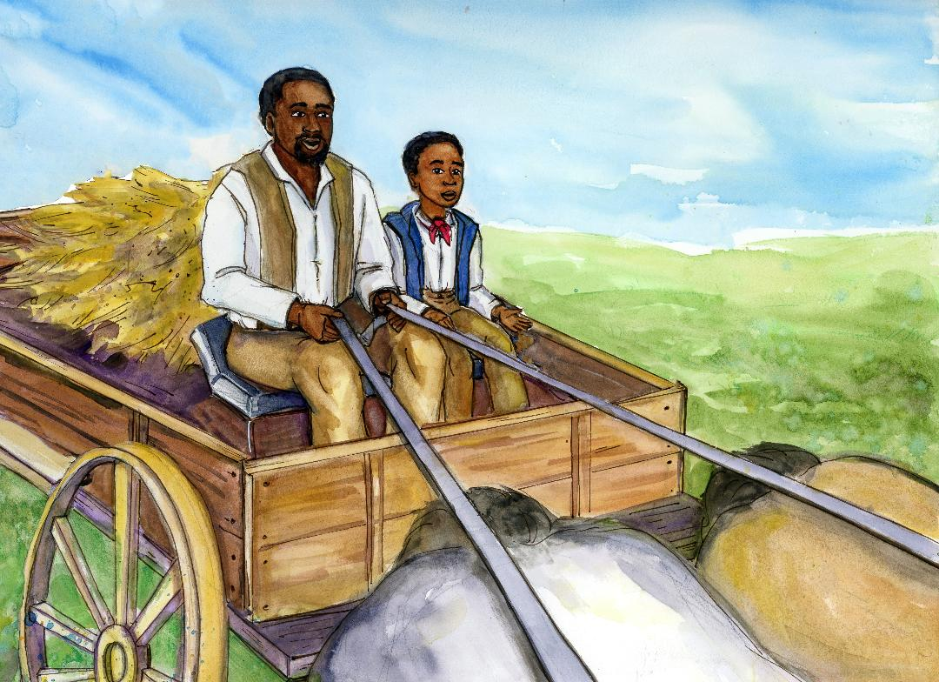
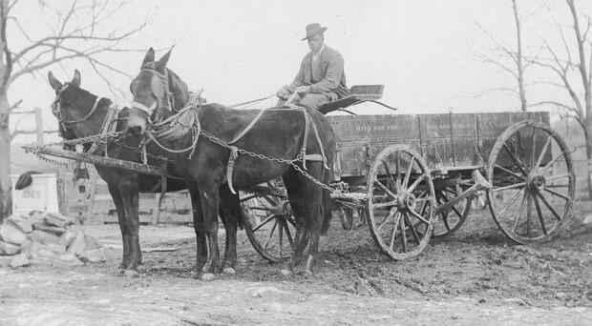
Chapter 8 Vocabulary
Debt: money owed that needs to be paid back
Buckboard wagon: horse-pulled carriage

Slide 9

Characters

Slide 10
Chapter 8 Characters
Sarah Smith

Slide 11

Summary

Slide 12
Chapter 8 Summary
The Professor tells a story he imagines may be similar to George’s experience.
George is having a difficult time adjusting to the Southall family, and wants to accompany Henry when he leaves again on the boat.
In this story, the Professor imagines that George broke a window, which is why he was arrested. He is sent to live with Nathan Smith, who paid for his court debt.
The story jumps ahead to Agnes Southall accompanying George to meet Nathan Smith.
George pleads with Agnes to let him stay with the Southalls, but Agnes refuses.

Slide 13
Chapter 8 Summary
Agnes says Henry can visit when George travels with Mr. Smith.
Nathan introduces himself to George, and asks him questions about himself.
George reveals he kept “scrapping and scrounging” because he couldn’t count on having a family forever.
George eventually opens up and explains his past to Mr. Smith.
Mr. Smith explains that the work George will be doing, farming, will be hard, but he will learn a lot.
Mr. Smith gives George some lemon drops and they continue on their way to his farm.

Slide 14

Step Away Activities

Slide 15
Chapter 8 Step Away Activities
Diary Entry #5: Leaving the Southalls
George’s Suitcase

Slide 16


Slide 17

