Slide 1
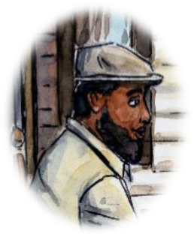
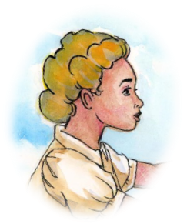
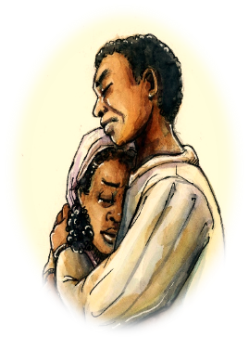
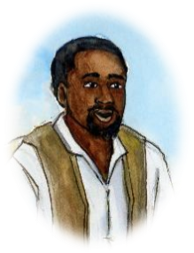

Chapter 7 Study Guide
Finding a Family

Slide 2

FOR THE TEACHER
Pre-reading class discussions
  Front-load Big Questions
  Brainstorm vocabulary
Introduce students to characters in the chapter
Read chapter as a class or in small groups
Review main plot points
Step Away Activities
  Diary Entry #4
  Collage

Slide 3

Big Questions

Slide 4

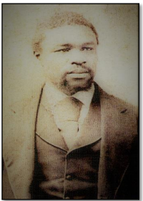
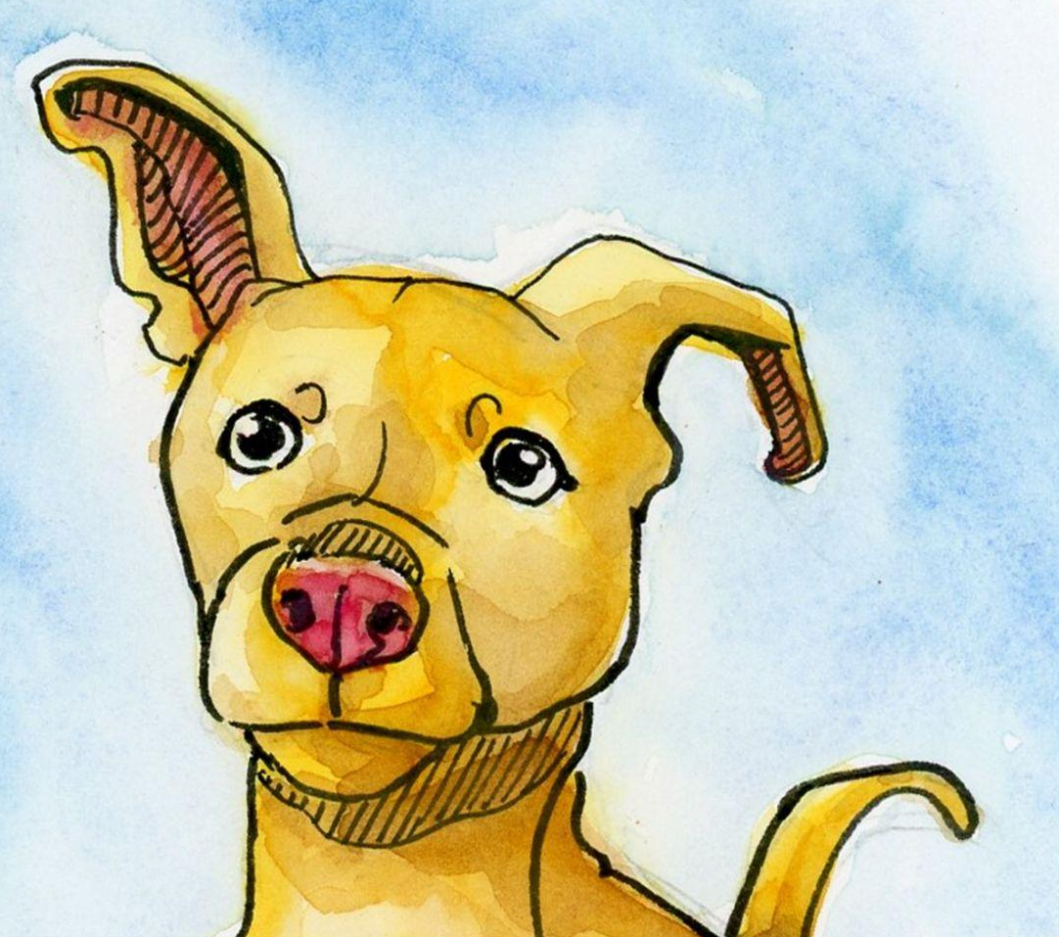
Chapter 7 Big Questions
What role did the Southalls play in George’s life? What lessons may George have learned from them?
Why did the law treat boys differently from girls?
What role did Nathan Smith play in George’s life? What kind of lessons may George have learned from him?
Why would “Porkchop” continue forward
in the story?

Slide 5
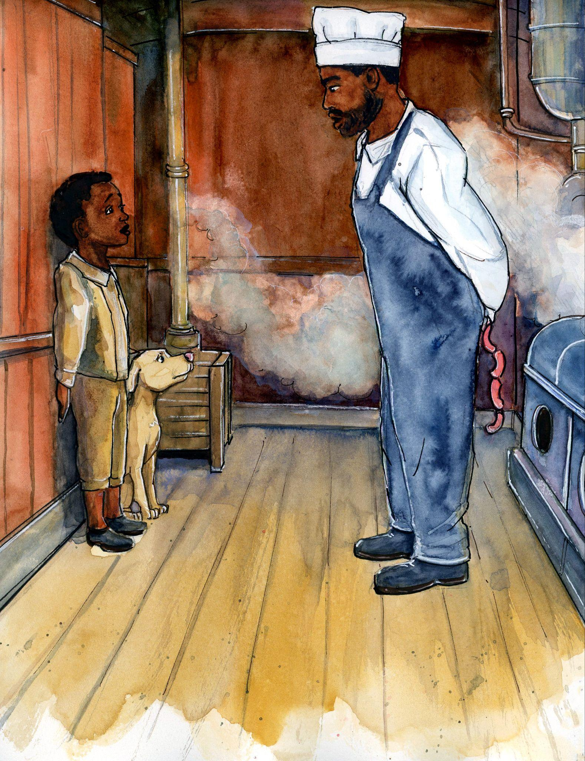
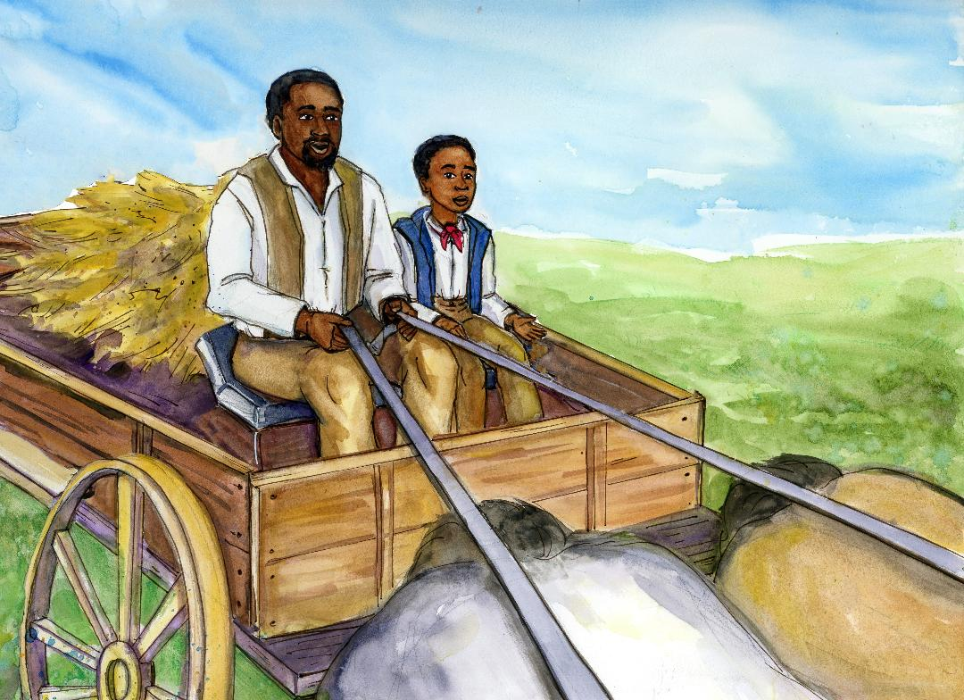
Chapter 7 Big Questions
What role did the Southalls play in George’s life? What lessons may George have learned from them?
Why did the law treat boys differently from girls?
What role did Nathan Smith play in George’s life? What kind of lessons may George have learned from him?
Why would “Porkchop” continue forward in the story?
After reading the chapter,
use the “Big Questions” in a class discussion.
Both Henry and Nathan stressed that George
stand by the truth and his word.
Why were these values important?

Slide 6

Vocabulary

Slide 7
Chapter 7 Vocabulary
What do these mean?
Stowaway
Politics
Union
Foster parents

Slide 8


Chapter 7 Vocabulary
Stowaway: someone who sneaks aboard a ship to travel
Politics: topics having to do with government (leaders, laws, policies, etc.)
Union: in our story, when workers band together to
fight for better wages, working conditions, and other
Demands
Foster parents: parents of a child or
children that are not biologically theirs

Slide 9

Characters

Slide 10
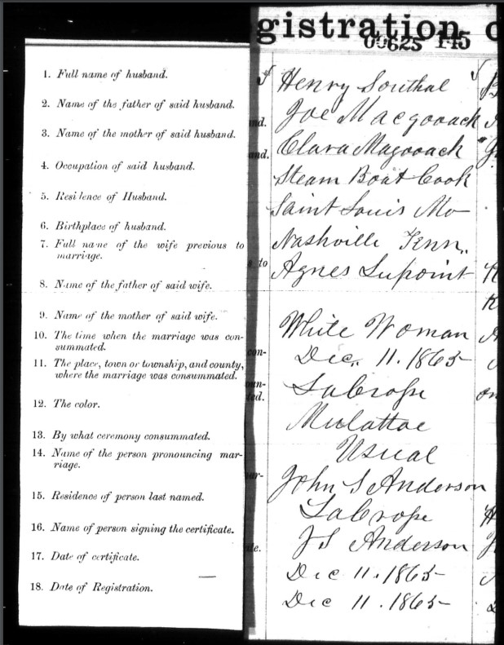
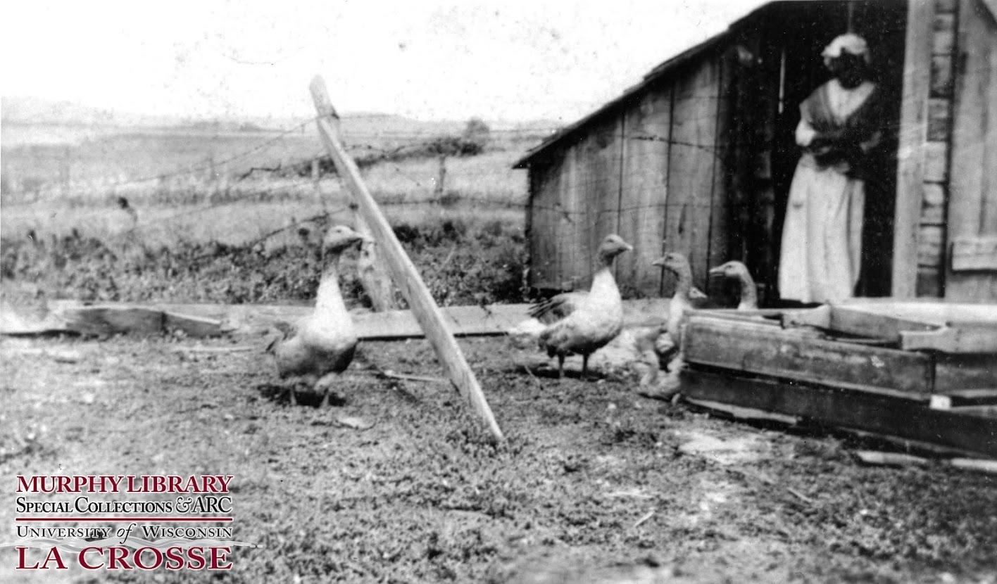
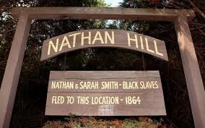
Chapter 7 Characters
Henry and Agnes Southall
Nathan and Sarah Smith

Slide 11

Summary

Slide 12
Chapter 7 Summary
Louis and Williamina return to the library and reunite with Freddie and the Professor.
They share the story they created about George’s possible experience there.
They show evidence that George’s journey on the Hawkeye State was highly likely to have happened. He traveled from Alton, Illinois to La Crosse, Wisconsin.
Professor explains that Henry was a slave in Tennessee before finding freedom

Slide 13
Chapter 7 Summary
When in La Crosse, George lived with Henry and Agnes Southall until he was 12 years old, when he was arrested (the crime was unknown).
The Professor and Williamina discuss how girls were treated differently from boys at the time - if they broke the law, they would have been returned to their parents or male relative.
The judge sent George to live with a man named Nathan Smith and his family on a farm. They took care of several young boys.
Nathan Smith was active in politics, especially with labor unions, in La Crosse.
The Southalls and Smith had a huge impact on George as he grew into an adult.
The Professor reveals he has his own imagined story about George to share.

Slide 14

Step Away Activities

Slide 15
Chapter 7 Step Away Activities
Collage
Diary Entry #4: George in Trouble

Slide 16


Slide 17

