Slide 1
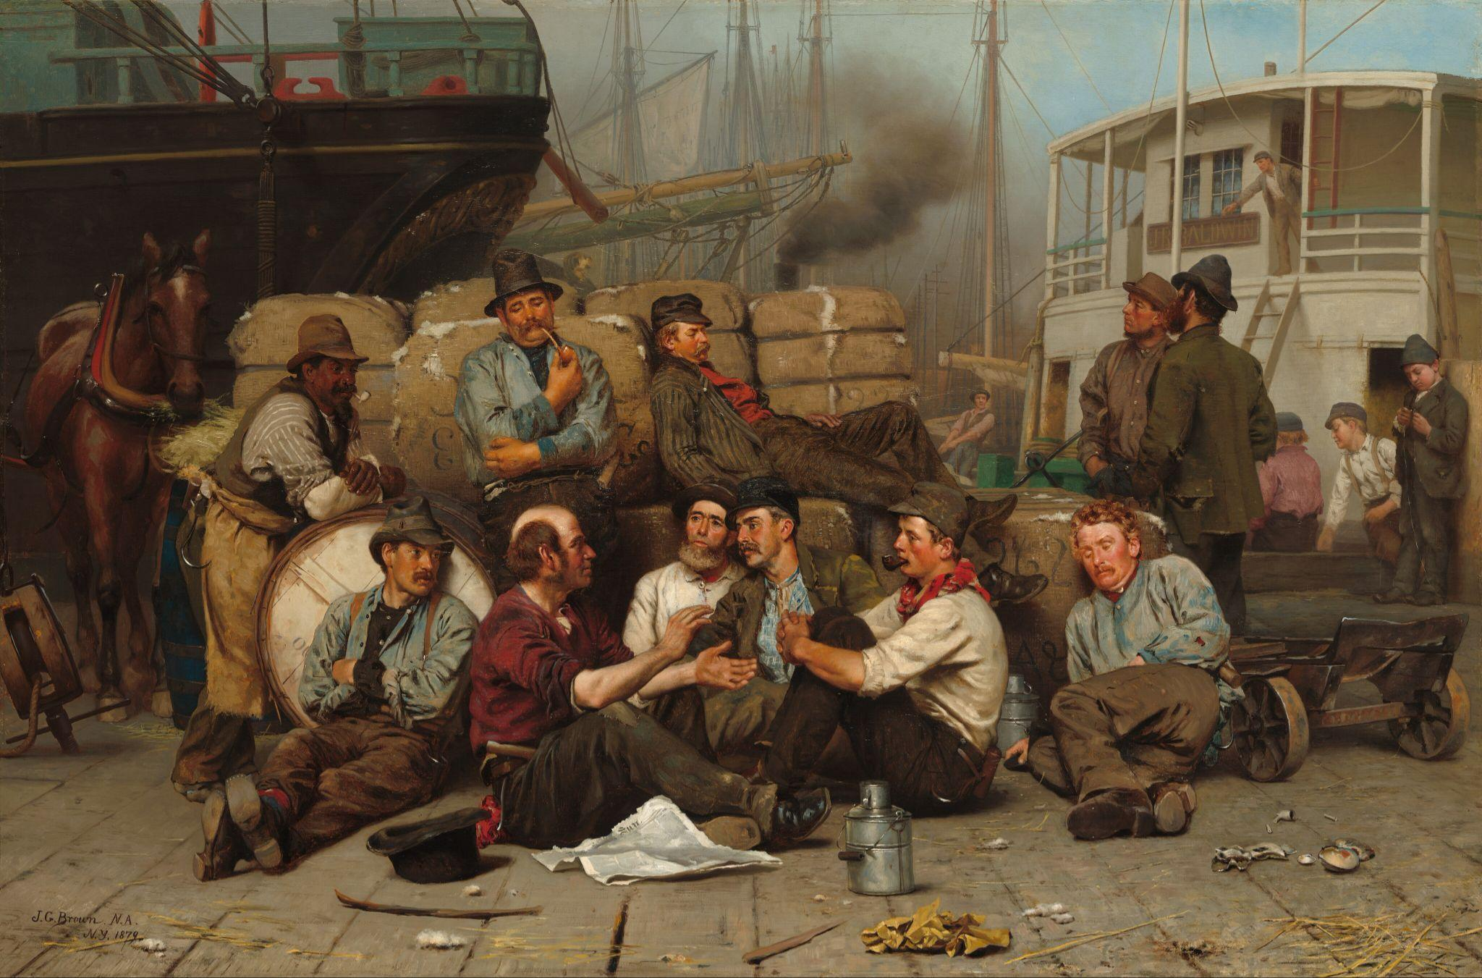

Chapter 6 Study Guide
Imagining Life
on the Wharf

Slide 2

FOR THE TEACHER
Pre-reading class discussions
  Front-load Big Questions
  Brainstorm vocabulary
Introduce students to characters in the chapter
Read chapter as a class or in small groups
Review main plot points
Step Away Activities
  Diary Entry #3
  Pet Stories

Slide 3

Big Questions

Slide 4
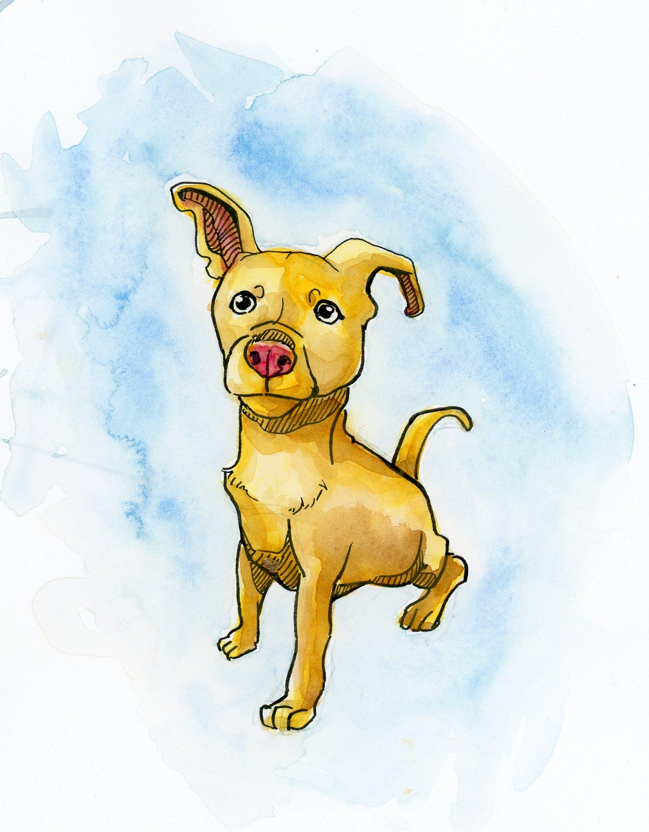
Chapter 6 Big Questions
Where did the Williamina and Louis get their ideas about their story?
What conditions did George experience living on the wharf?
Why did Williamina and Louis imagine a pet dog for George? What purpose does the dog serve?
Why would George want to stay on the wharf?
After reading the chapter, use the above “Big Questions” in a class discussion.
How does Porkchop represent what is missing in George’s life?

Slide 5

Vocabulary

Slide 6
Chapter 6 Vocabulary
What do these mean?
Civil War
Wharf
Longshoremen
Lean-to
Freight
Gangplank

Slide 7
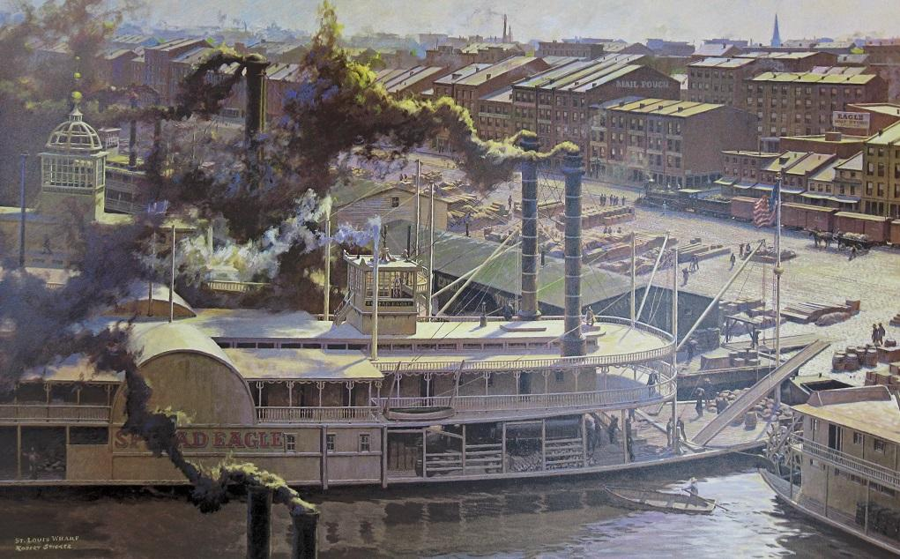
Chapter 6 Vocabulary
Civil War: a violent four year United States conflict in which Northern states fought Southern states; one of the main causes was slavery.
Wharf: a place near a body of
water where ships are loaded and
unloaded
Longshoremen: someone who
loads and unloads boats at a wharf

Slide 8
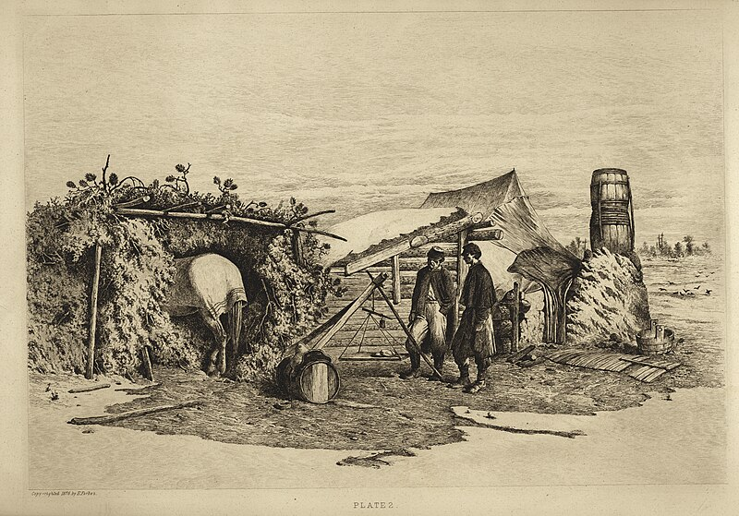
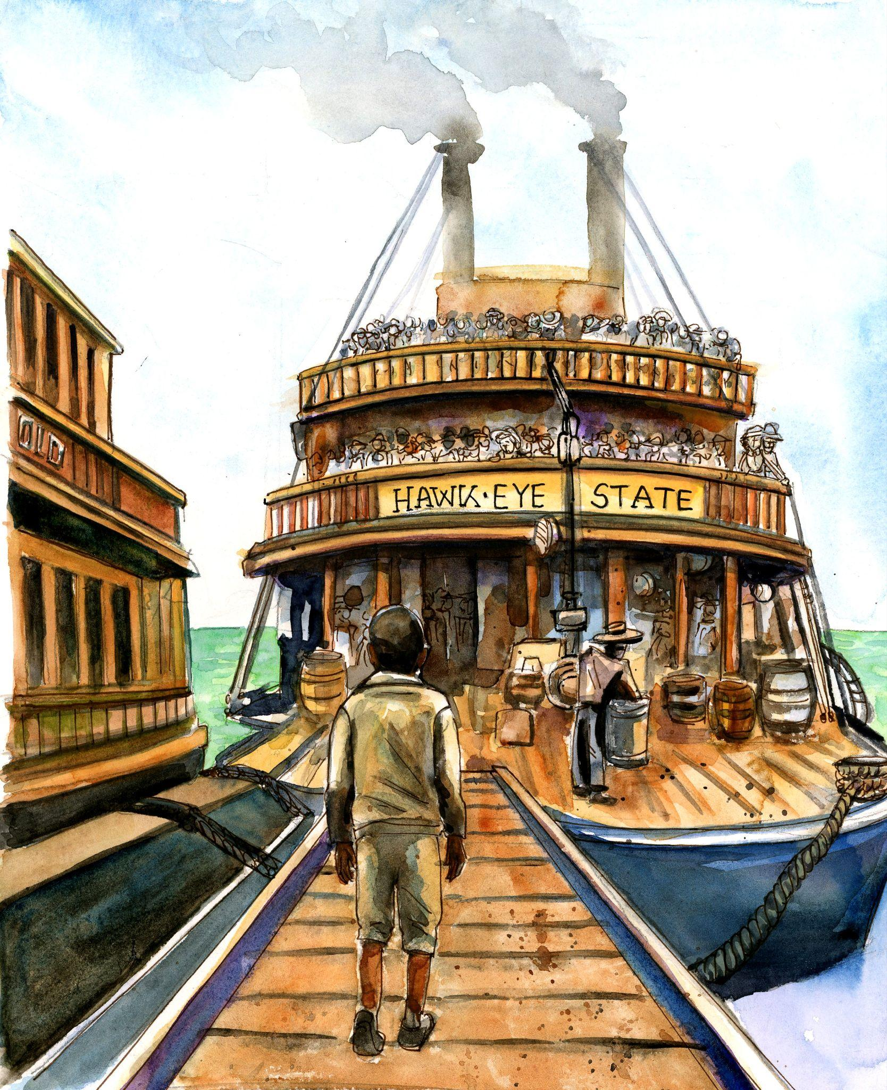
Chapter 6 Vocabulary
Lean-to: a small room on the outside of a building
that “leans” against the main building
Freight: goods transported in bulk (large numbers);
in this case, by ship
Gangplank: a removable wooden pathway used to
move between land and a ship

Slide 9

Characters

Slide 10
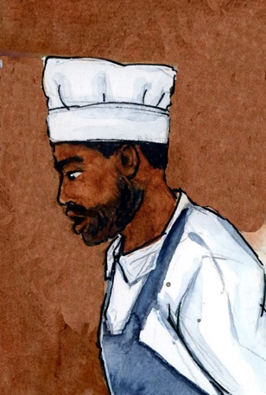
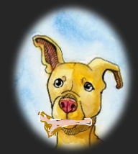
Chapter 6 Characters
Porkchop
(Dog’s name)
Henry Southall
(Cook on Hawkeye State)

Slide 11

Summary

Slide 12
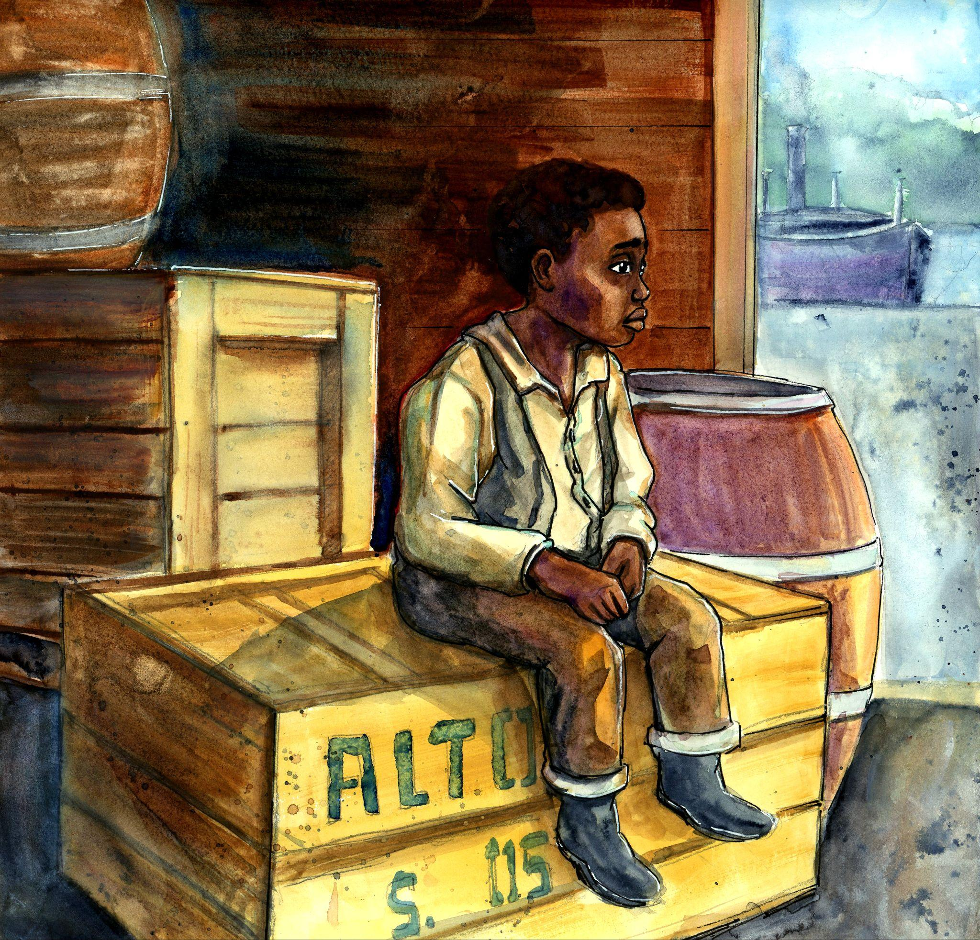
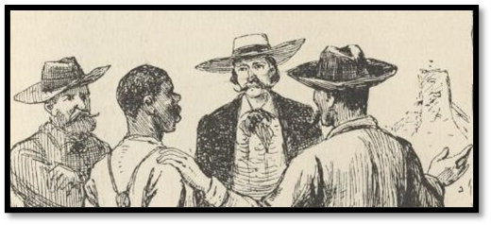
Chapter 6 Summary
While visiting the wharf, the Researchers imagine a
story that may have been similar to George’s
experiences.
In the story, George sleeps in shipping crates and scavenges for food and other necessities.
Guards on the wharf warn George about slave
catchers and bounty hunters.

Slide 13
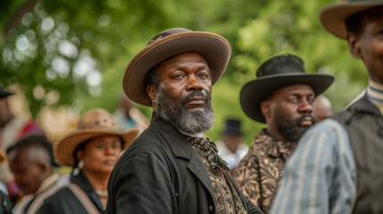
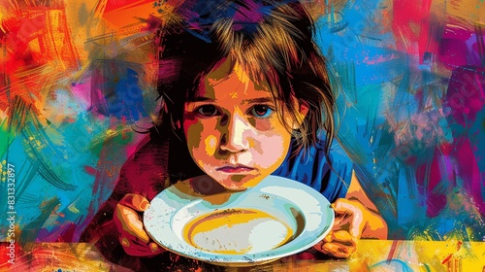
Chapter 6 Summary
George witnesses the effects of the Civil War
on the activity in the wharf.
In the story, George has befriended a stray dog named “Porkchop”.
George and Porkchop were often hungry - there was limited food available to them.

Slide 14
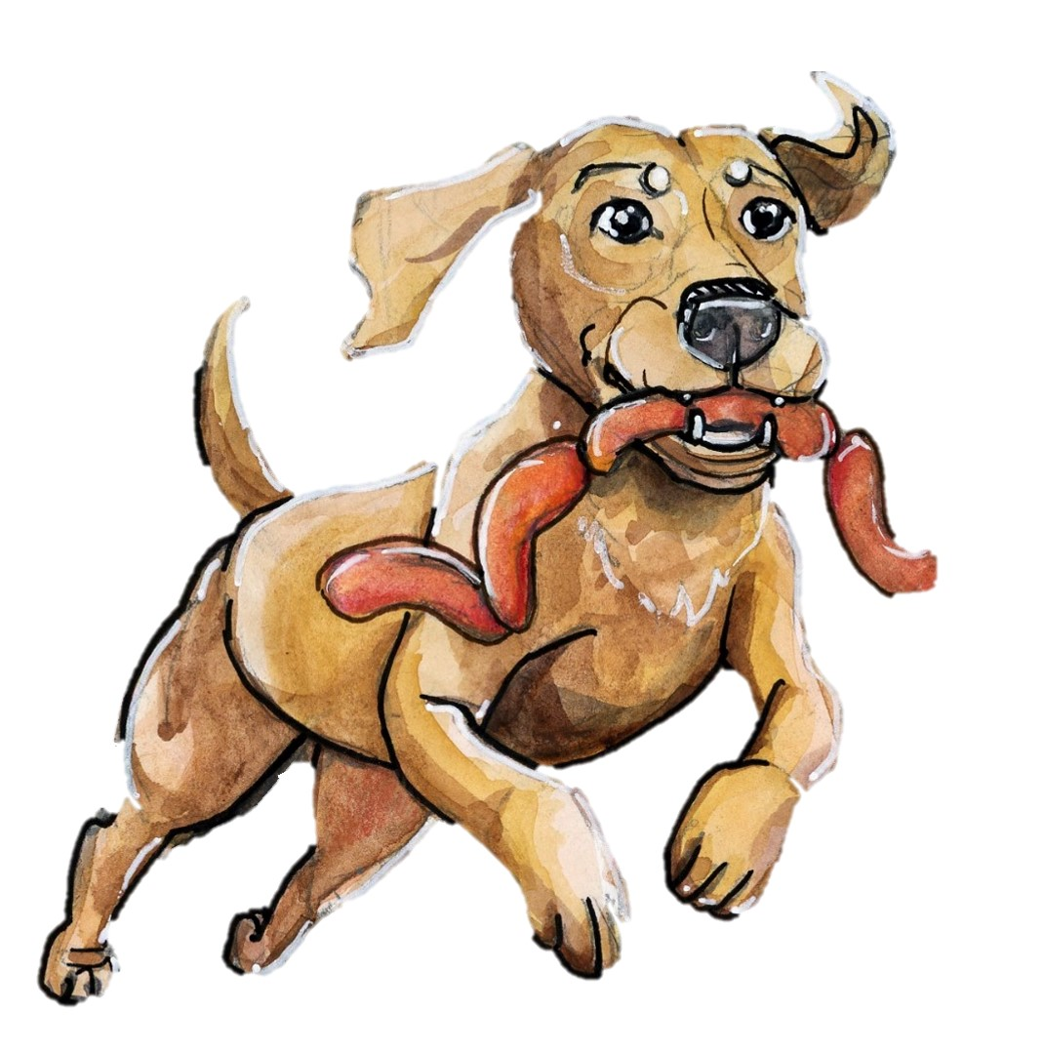
Chapter 6 Summary
After daydreaming one day, George realizes Porkchop is missing.
George tracks Porkchop down, only to find the dog has stolen a string of sausages from a ship’s cook (Henry), who is also chasing the dog.
George and Porkchop discover hard lessons
Henry jokes that George owes him for the sausages,
and invites George to travel upriver on the
Hawkeye State.

Slide 15

Step Away Activities

Slide 16
Chapter 6 Step Away Activities
Diary Entry #3: Living on the Wharf
Pet Stories

Slide 17


Slide 18

