Slide 1
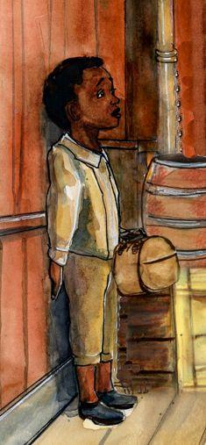

Chapter 5 Study Guide
Alone

Slide 2

FOR THE TEACHER
Pre-reading class discussions
  Front-load Big Questions
  Brainstorm vocabulary
Read chapter as a class or in small groups
Review main plot points
Step Away Activities
  Diary Entry #2
  Gallery Walk
  Odd Fellows

Slide 3

Big Questions

Slide 4
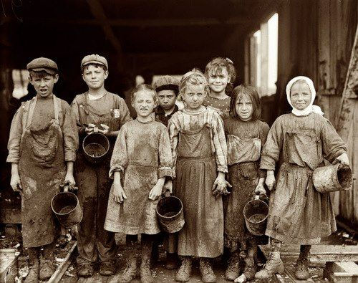
Chapter 5 Big Ideas
Why were there so many orphans during George’s time?
What groups helped orphans during the time?
Why were orphans put into workhouses?
What do you think conditions were like? What kind of work did they do?
After reading the chapter, use the above “Big Questions” in a class discussion.
Would you have stayed in a workhouse or lived on the street? WHY?

Slide 5

Vocabulary

Slide 6

Chapter 5 Vocabulary
What do these mean?
Street vendor
Merchant
Hub
Workhouse

Slide 7
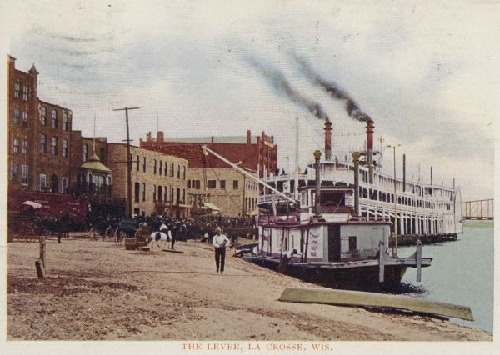
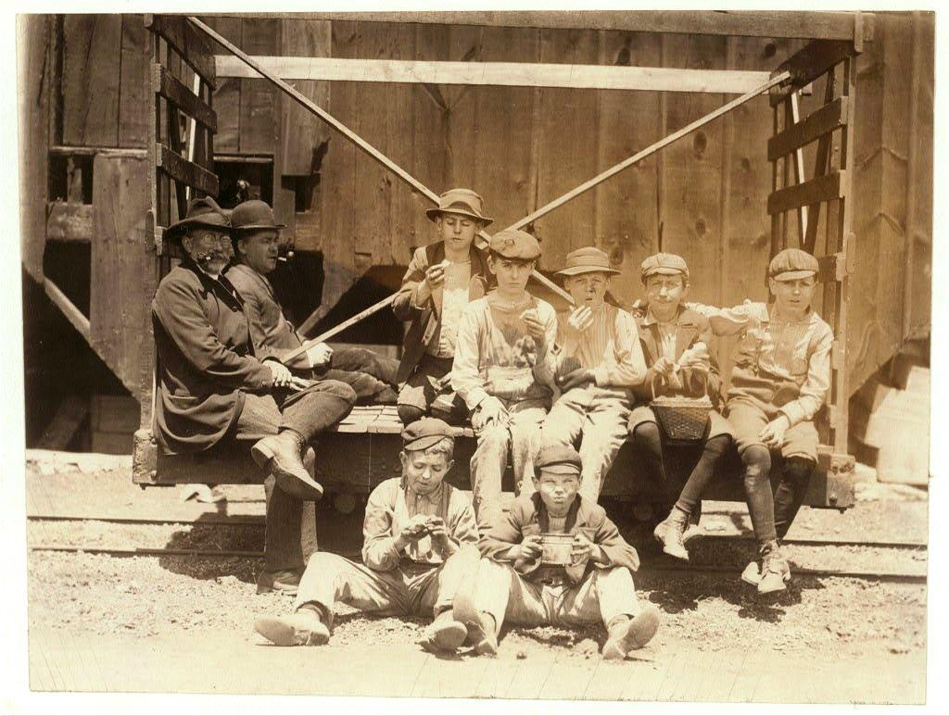
Chapter 5 Vocabulary
Street vendor: someone who sells goods on the streets
        Merchant: someone who ships and sells good
        Hub: a center of trade and shopping
Workhouse: poor people worked off debt;
living in terrible conditions in exchange
for a bed and food.

Slide 8

Summary

Slide 9
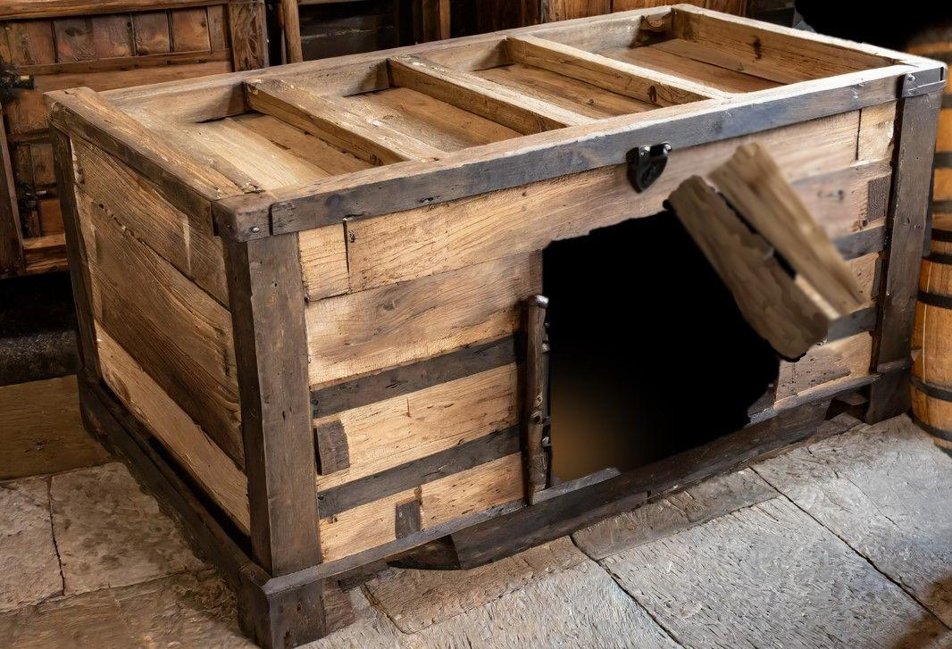
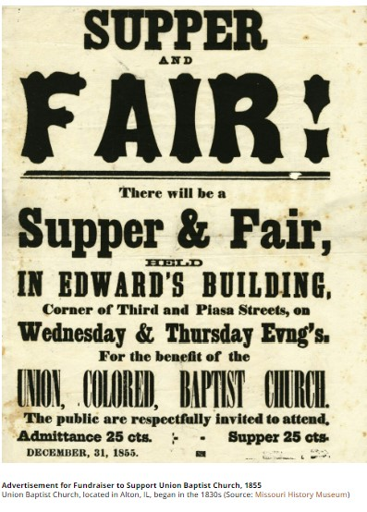
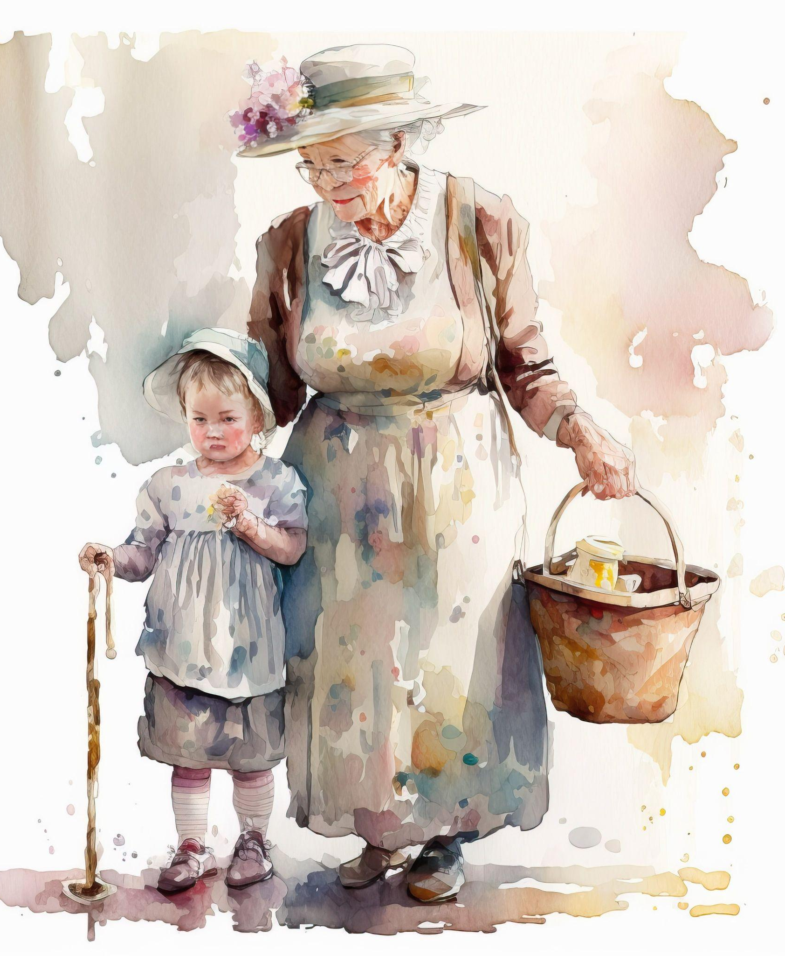
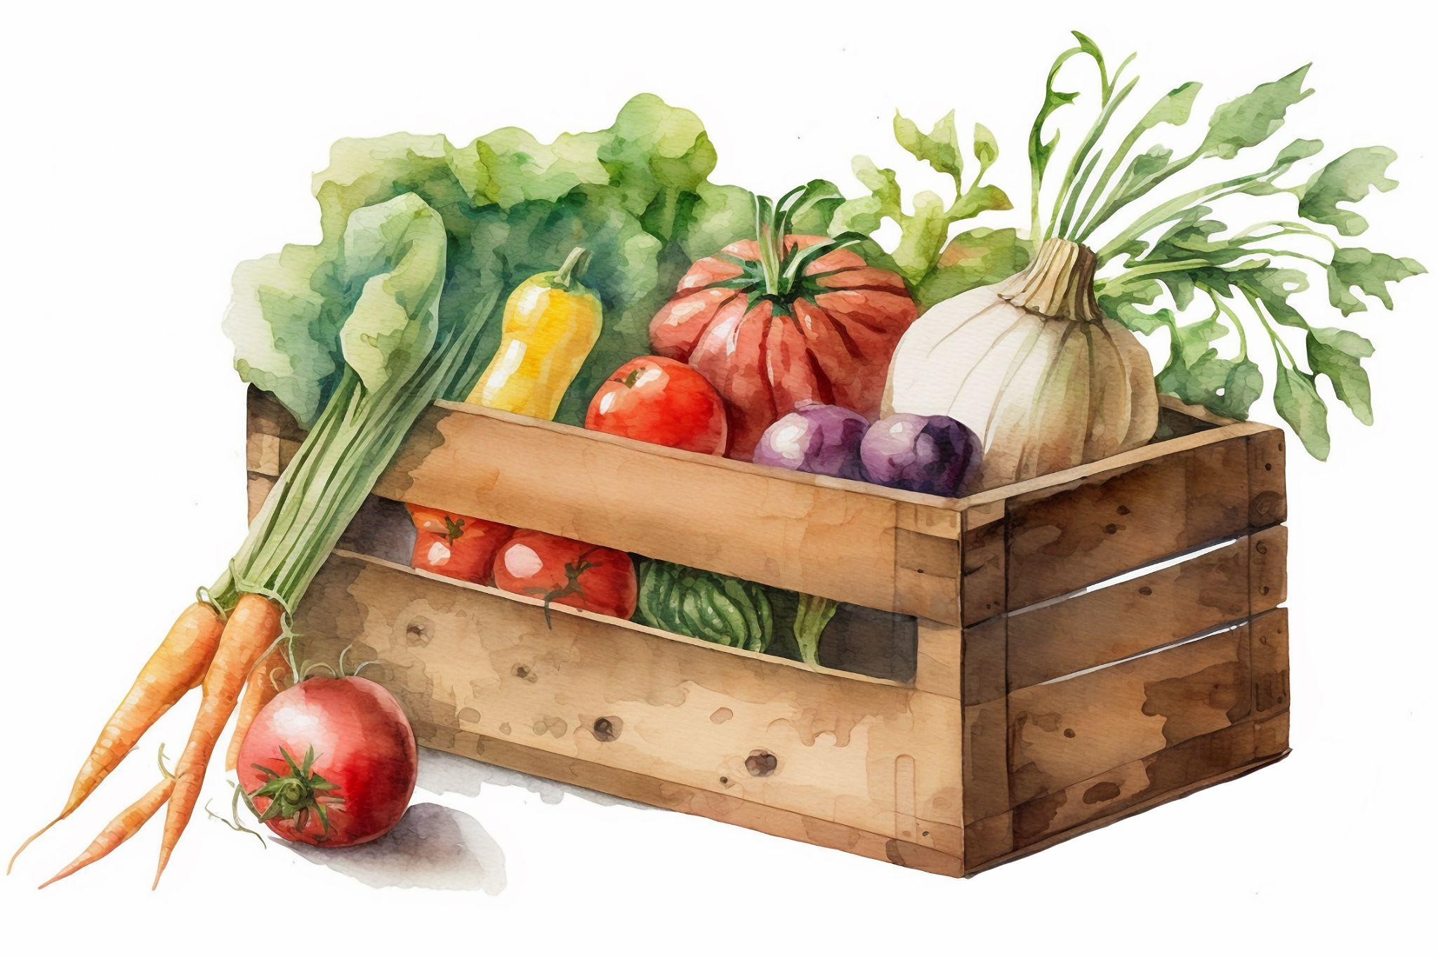
Chapter 5 Summary
Williamina discovers George became an orphan a 5, he
lived in a shipping crate along the wharf for 3 years.
George may have received meals and other help from
local churches.
Other groups, like the Odd Fellows and Women’s
Social Groups, may have also helped.

Slide 10
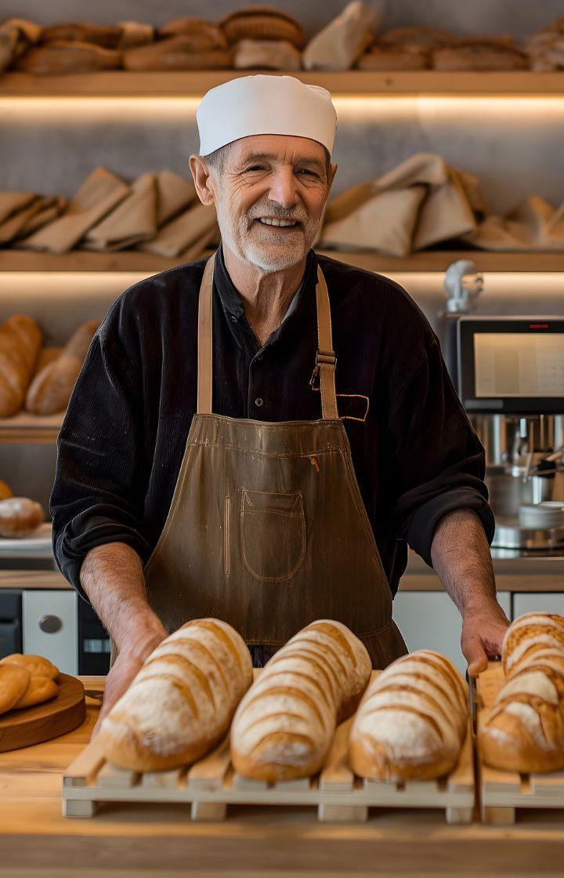

Chapter 5 Summary
Freddie wonders if George made friends with the wharf
workers and street venders.
Often, children were taken to workhouses where they were forced to work, and were often abused.
The researchers wonder if George may have also
befriended a stray dog or other animals.

Slide 11

Step Away Activities

Slide 12
Chapter 5 Step Away Activities
Diary Entry #2: Workhouse Orphans
Gallery Walk
Odd Fellows

Slide 13


Slide 14

