Slide 1
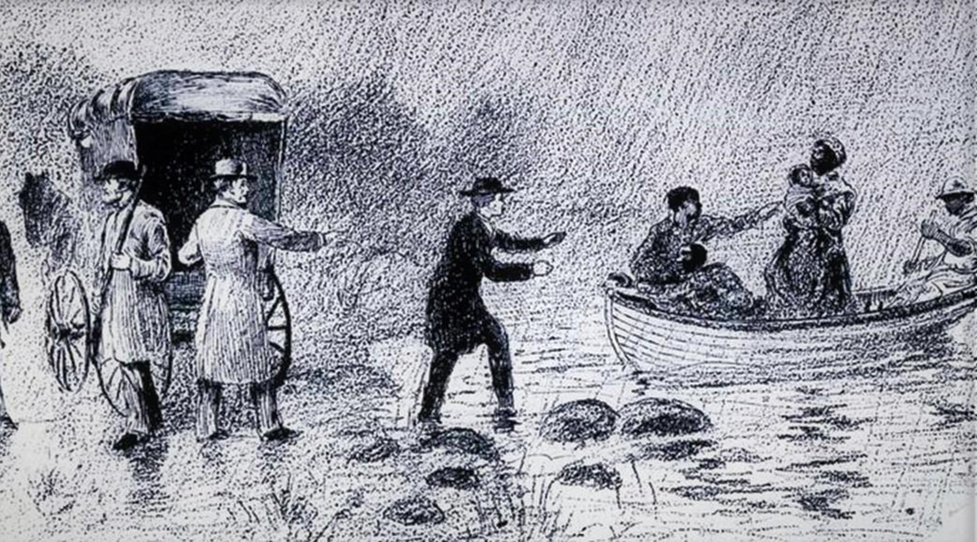

Chapter 4 Study Guide
Runaways, Bounty Hunters, and Illness

Slide 2

FOR THE TEACHER
Pre-reading class discussions
  Front-load Big Questions
  Brainstorm vocabulary
Read chapter as a class or in small groups
Review main plot points
Step Away Activities
  Civil Rights Leaders

Slide 3

Big Questions

Slide 4
Chapter 4 Big Questions
What were some of George’s accomplishments?
Why do you think he is not well known?
What challenges did Free and Runaway African Americans face?
How does Historical Fiction make stories more interesting? How does this affect how true the stories are? Can these stories be trusted?
After reading the chapter, use the above “Big Questions” in a class discussion.
How are you going to write about George and his life?

Slide 5

Vocabulary

Slide 6

Chapter 4 Vocabulary
What do these mean?
Civil Rights
Persuade
Property
Conductors (hint: Underground Railroad)
Legal
Bounty hunter
Emancipation Papers
Warrant
Poverty

Slide 7
Chapter 4 Vocabulary
Civil Rights: guaranteed freedoms and protections
Persuade: to convince someone to believe or do something
Property: something of value that belongs to someone
Slaves were not seen as people, they were seen as property
Conductors: in slavery times, people who helped runaway slaves along the Underground Railroad (see Chapter 3)
Legal: based in the law

Slide 8
Chapter 4 Vocabulary
Bounty hunter: searcher for escaped slaves
Emancipation Papers: documents to prove a person’s freedom
Warrant: a legal document allowing police or other authority to make an arrest
Poverty: state of being extremely poor; not having the necessities to survive comfortably

Slide 9

Summary

Slide 10
Chapter 4 Summary
The Professor returns to find his researchers at work.
The students discovered Primary Documents showing George Edwin Taylor fought for labor rights, and later for civil rights.
They discover that Taylor had a newspaper called the Wisconsin Labor Advocate.
Frederick Douglass called to Taylor the “voice” for Black people in the Midwest.
Researchers are surprised that George is not more well known.

Slide 11
Chapter 4 Summary
The students discover that many newspapers used exaggerated language to make stories more interesting.
  For example, they referred to “stampedes of slaves” running across state borders.
The Professor warns students you have to be careful about what words are used and how they persuade people.
People had to choose between doing what was right (protect/help slaves) vs what was legal (support slavery systems and laws).

Slide 12
Chapter 4 Summary
The students learn about “bounty hunters” who hunted down runaway slaves. They often arrested people that were not even slaves.
Amanda Hines arrived in Alton, Illinois in 1860 with her son, George. George became an orphan 2 years later when Amanda died of tuberculosis.
Poverty was a major cause of the spread of disease.
The students reflect on how lucky George was to not get sick or get caught by bounty hunters.

Slide 13

Step Away Activities

Slide 14
Chapter 4 Step Away Activities
Civil Rights Leaders

Slide 15


Slide 16

