Slide 1
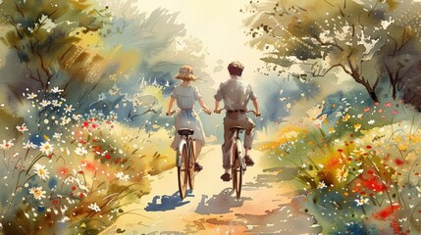

Chapter 3 Study Guide
Picking Up Clues, and Friends

Slide 2

FOR THE TEACHER
Pre-reading class discussions
  Front-load Big Questions
  Brainstorm vocabulary
Introduce students to characters in the chapter
Read chapter as a class or in small groups
Review main plot points
Step Away Activities
  Library Magic

Slide 3
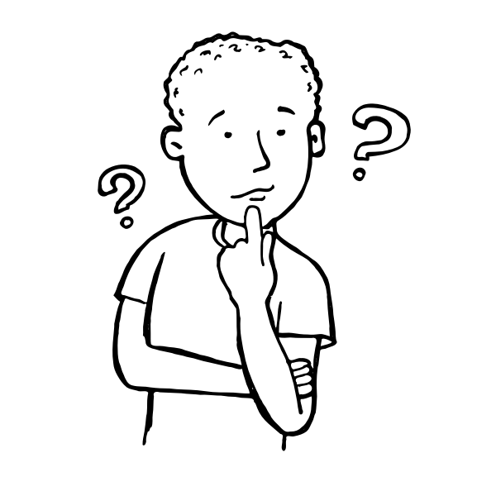
Big Questions

Slide 4

Chapter 3 Big Questions
How do we preserve important documents?
Why do we preserve important documents?
PRE-READING CLASS DISCUSSION:
have students
  write ideas on board, or
  write on sticky notes and
    stick to the board or large paper.

Slide 5
Chapter 3 Big Questions
How do we preserve important documents?
Store in a safe area; make sure environment is not too hot, cold, or humid;
use gloves; use special kind of paper, ink, storage cartons or containers, and more

Slide 6
Chapter 3 Big Questions
Why do we preserve important documents?
So we can understand
  different cultures,
  where we come from (in general, your family, yourself),
  lessons from the past,
    so future generations can learn about us and our time, and more

Slide 7

Vocabulary

Slide 8
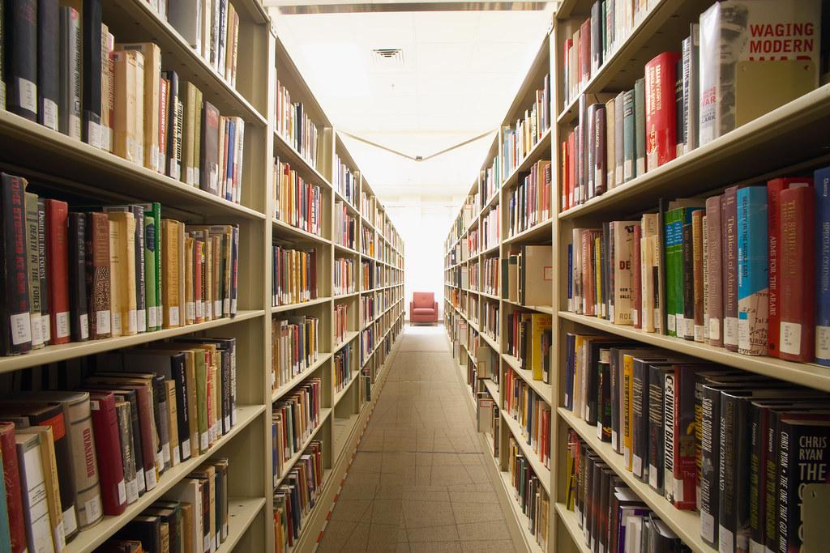
Chapter 3 Vocabulary
What do these mean?
Archive (verb and noun)
Archivist
Archeologist

Slide 9
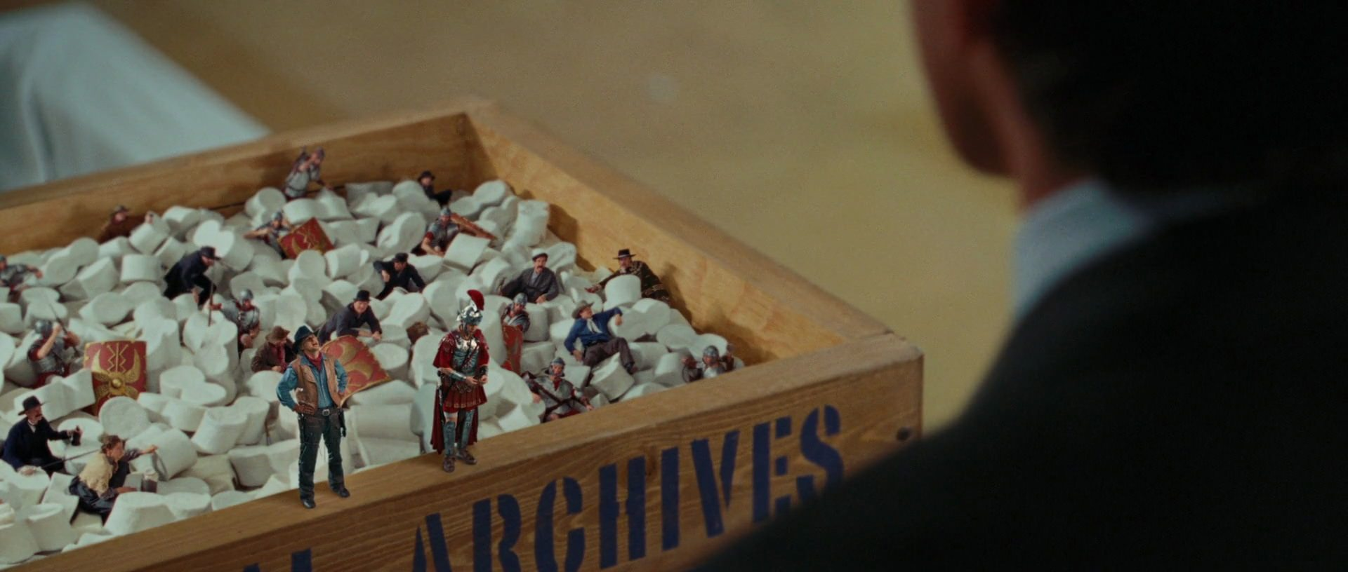
Chapter 3 Vocabulary
Archive (verb): to organize important documents, artifacts, or ideas in a safe place (action)
Was this a safe place for Jedediah and his friends in the
Night at the Museum?
Why or Why not?

Slide 10

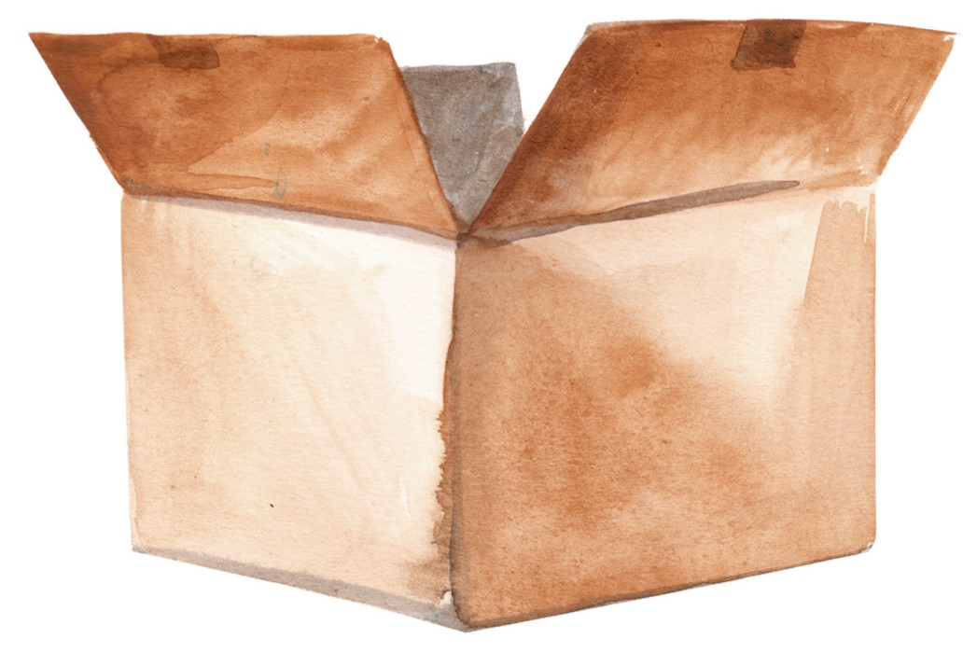
Chapter 3 Vocabulary
Archive (noun): a safe storage place for important documents, artifacts, and ideas (person, place, or thing)
Locked case with air and light control
Which is better?
Why?
Paper box in your basement

Slide 11
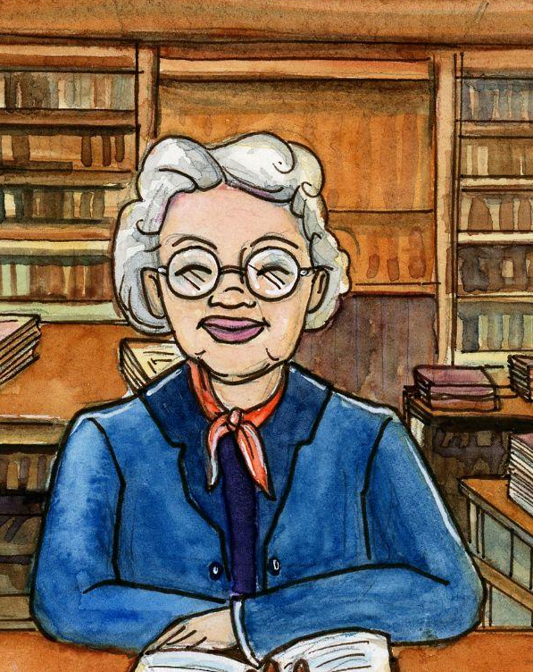
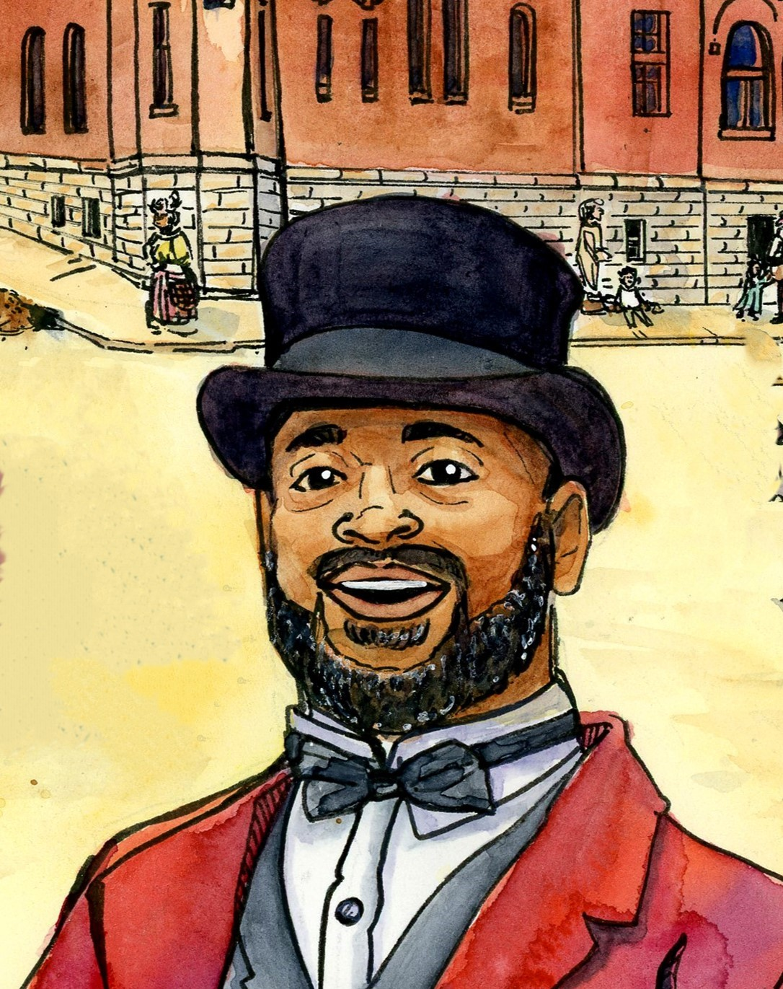
Chapter 3 Vocabulary
Archivist: a person who organizes, saves, and keeps
important documents, artifacts, and ideas safe
Archeologist: a person who studies human history
through artifacts (objects) from the past

Slide 12
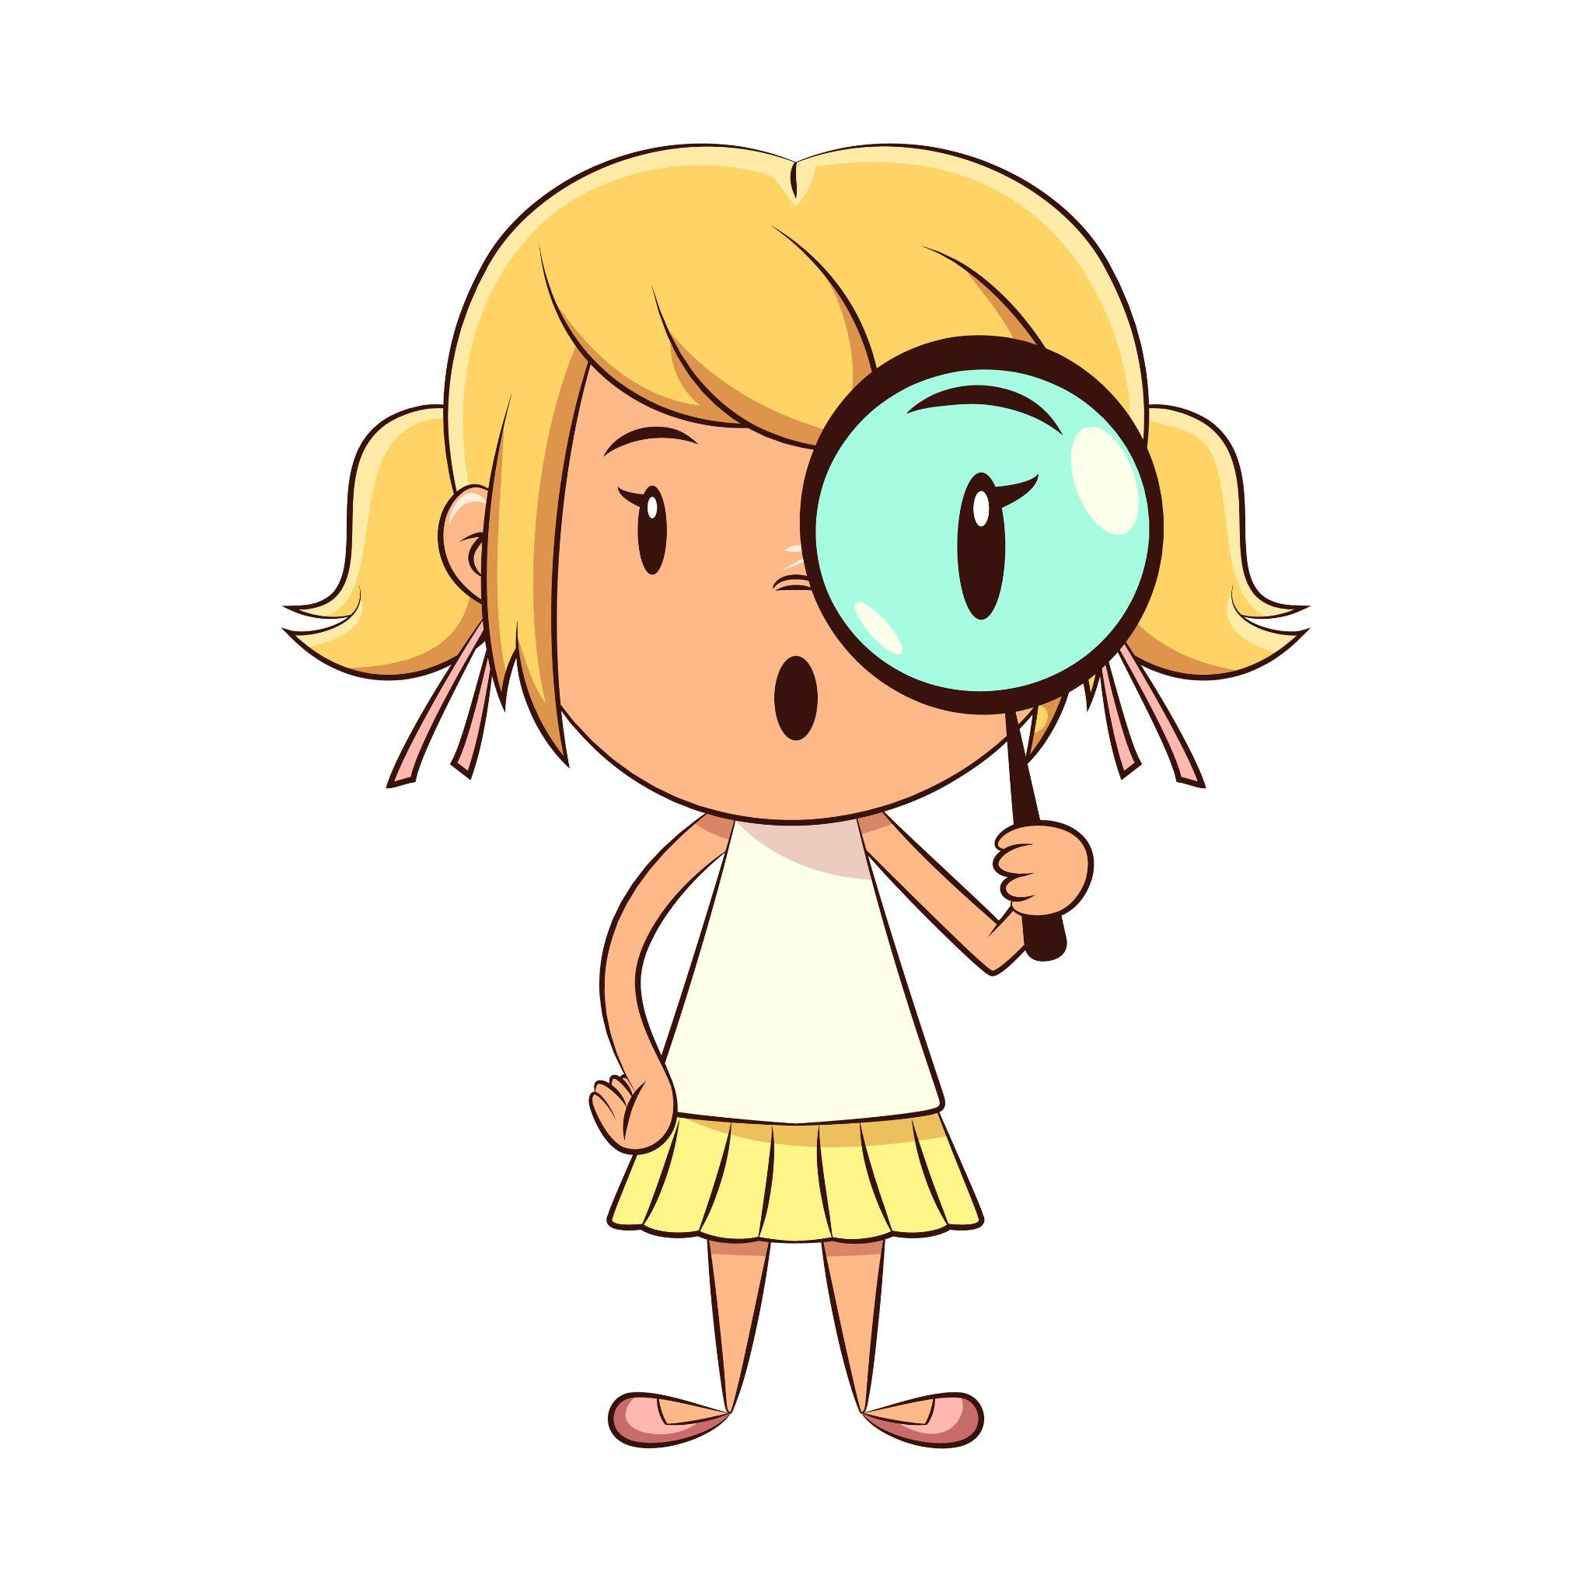
Characters

Slide 13
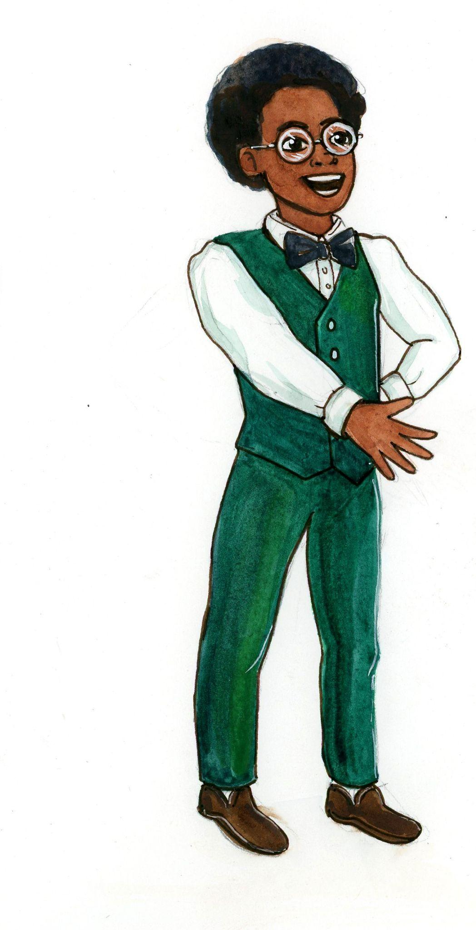
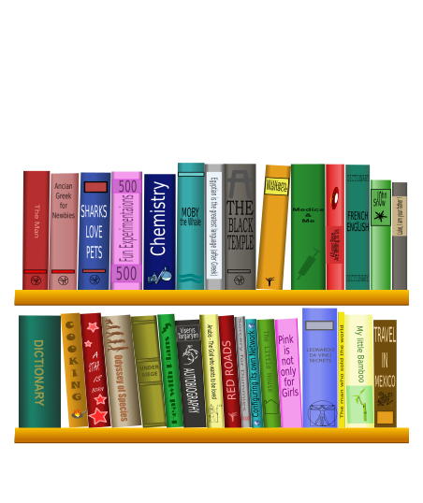
Chapter 3 Characters
Mrs. Dolbee
Freddie
(Mr. Organization)

Slide 14

Summary

Slide 15
Chapter 3 Summary
Louis and Williamina arrive at the Alton Library.
The researchers meet Mrs. Dolbee, the library archivist.
Mrs. Dolbee explains how the library protects its materials.
Mrs. Dolbee introduces Freddie (“Mr. Organization”), who will help them with their research.
Researchers explain who George is and how he arrived in Alton.
Freddie is surprised he never heard of George before, especially because he was the first African American man to run for President.
Researchers get to work.

Slide 16
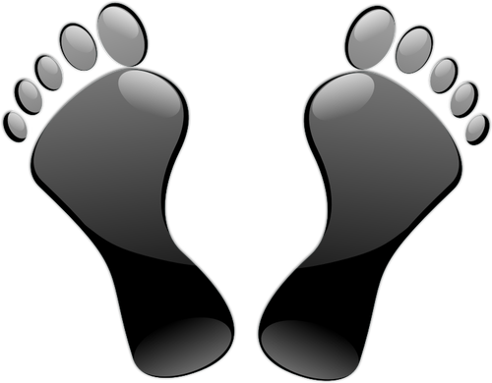
Step Away Activities

Slide 17
Chapter 3 Step Away Activities
Library Magic

Slide 18


Slide 19

