Slide 1
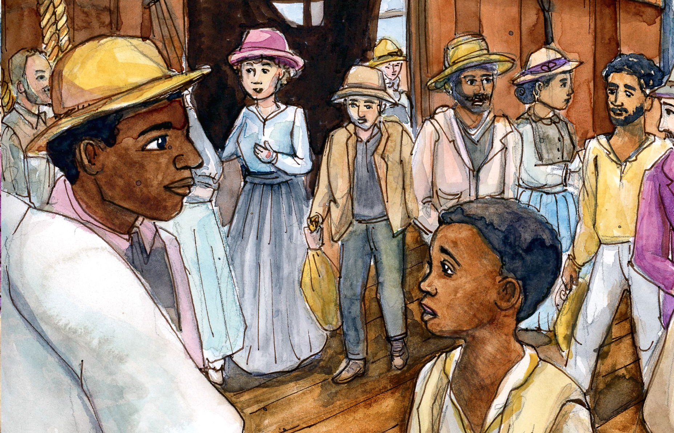

Chapter 2 Study Guide
Free? Or Slave?

Slide 2

FOR THE TEACHER
Pre-reading class discussions
  Front-load Big Questions
  Brainstorm vocabulary
Introduce students to characters in the chapter
Read chapter as a class or in small groups
Review main plot points
Step Away Activities
  Diary Entry #1
  Where is George?

Slide 3

Big Questions

Slide 4

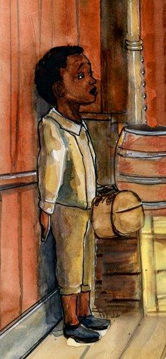
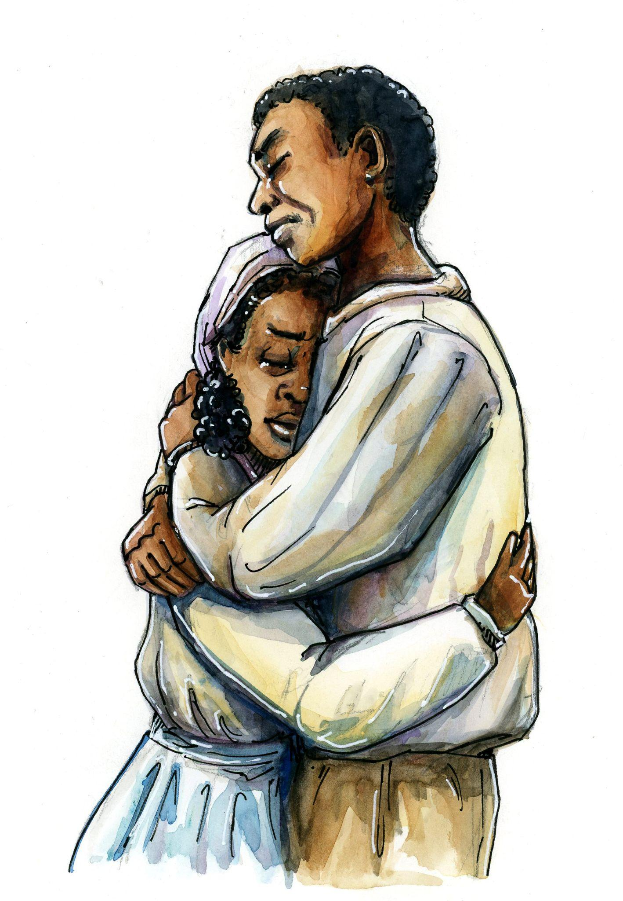
Chapter 2 Big Questions
How was George Edwin Taylor’s childhood different or same as yours?
How was “Jumping the Broom” different from a traditional wedding?
If you were Amanda Hines, would you stay with Bryant Taylor?
Do you think there were women who did stay with their
husbands?
After reading the chapter, use answer the following in a class discussion.
Why would the census show Amanda Hines had more children than her own?

Slide 5

Vocabulary

Slide 6

Chapter 2 Vocabulary
What do these mean?
Freemen
Master
Rebellion
Protest
Underground Railroad
Census
Plantation

Slide 7
Chapter 2 Vocabulary
Freemen: a person who is free; never enslaved
Freedman: a person who was freed from enslavement
Master: someone who “owned” people who were slaves
Rebellion: open resistance to a leader, ruler, or government
Protest: to openly show disagreement about an issue

Slide 8
Chapter 2 Vocabulary
Underground Railroad: a series of routes escaped slaves took to reach the Northern states, where there was no slavery
Census: an official, legal count of the population in a country
Plantation: a large estate made up of many farms; worked by slaves in the time of American slavery

Slide 9
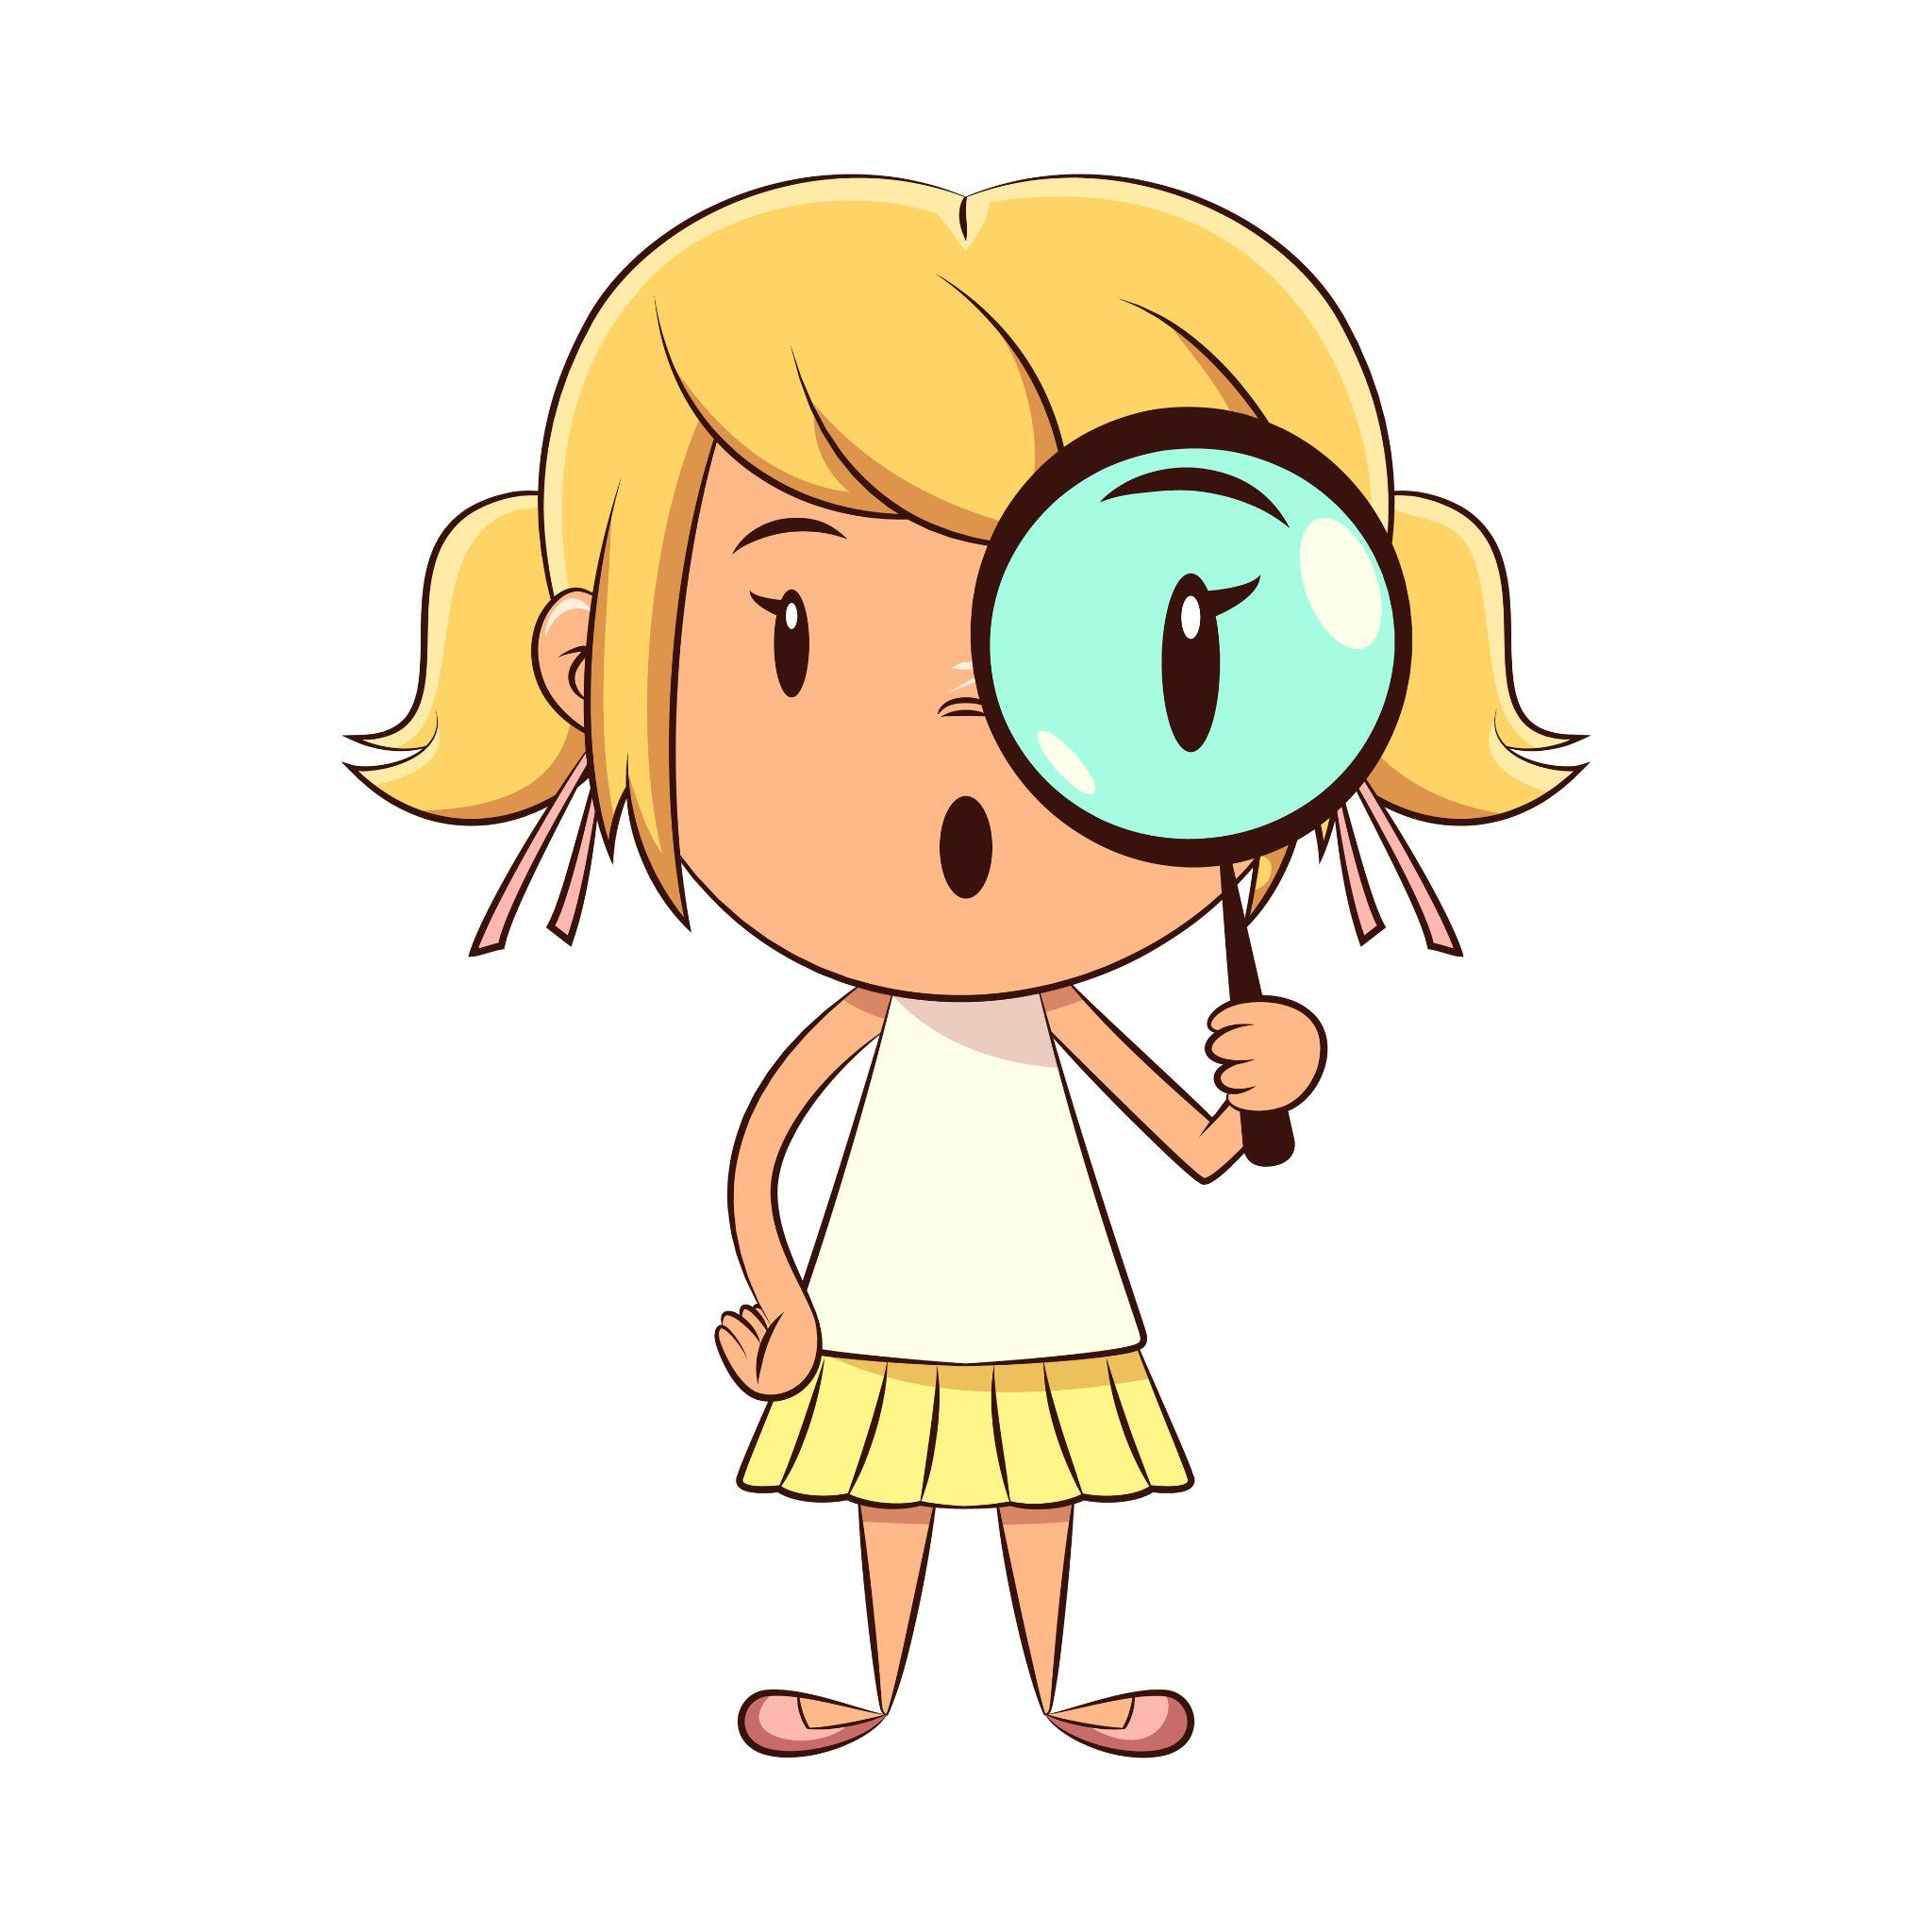
Characters

Slide 10
Chapter 2 Characters
Amanda Hines
Bryant Taylor

Slide 11

Summary

Slide 12
Chapter 2 Summary
The Professor introduces us to George’s parents, Amanda Hines and Bryant Taylor.
Amanda was a free woman, Bryant was enslaved, and they met on a plantation in Arkansas.
The Professor explains that George was free, because his mother was free
The Professor explains why and how Amanda and Bryant were married by “Jumping the Broom.”

Slide 13
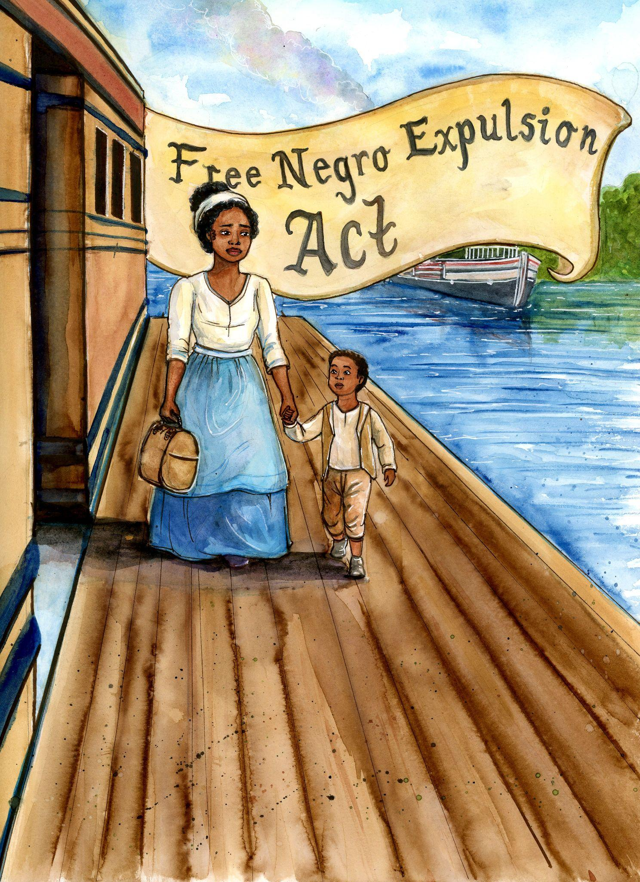
Chapter 2 Summary
Arkansas government were scared of slave rebellions,
so they forced all freemen of color to leave the state.
This meant that Amanda and George had to
leave Bryant behind.
The Professor explains that many states tried to
separate freemen and slaves. They did not want
slaves to have access to the Underground Railroad.

Slide 14

Step Away Activities

Slide 15
Chapter 2 Step Away Activities
Diary Entry #1: Amanda Hines

Slide 16


Slide 17

