Slide 1
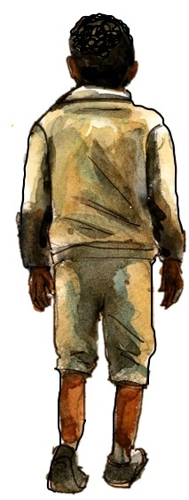

Chapter 1
Study Guide
The Journey Begins

Slide 2

FOR THE TEACHER
Pre-reading class discussions
  Front-load Big Questions
  Brainstorm vocabulary
Introduce students to characters in the chapter
Read chapter as a class or in small groups
Review main plot points
Step Away Activities
  Types of Bad Evidence
  Unboxing History

Slide 3
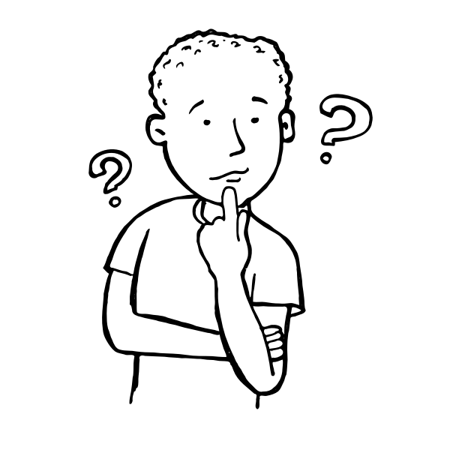
Big Questions

Slide 4

Chapter 1 Big Questions
How do we learn about the past?
PRE-READING CLASS DISCUSSION:
  write ideas on board, or
  have students write responses on sticky notes and
    stick to the board or large paper.
watch
You tube: How I Designed an Inclusive Socratic Seminar (And So Can You)
https://www.youtube.com/watch?v=VeoGKQKXdps

Slide 5
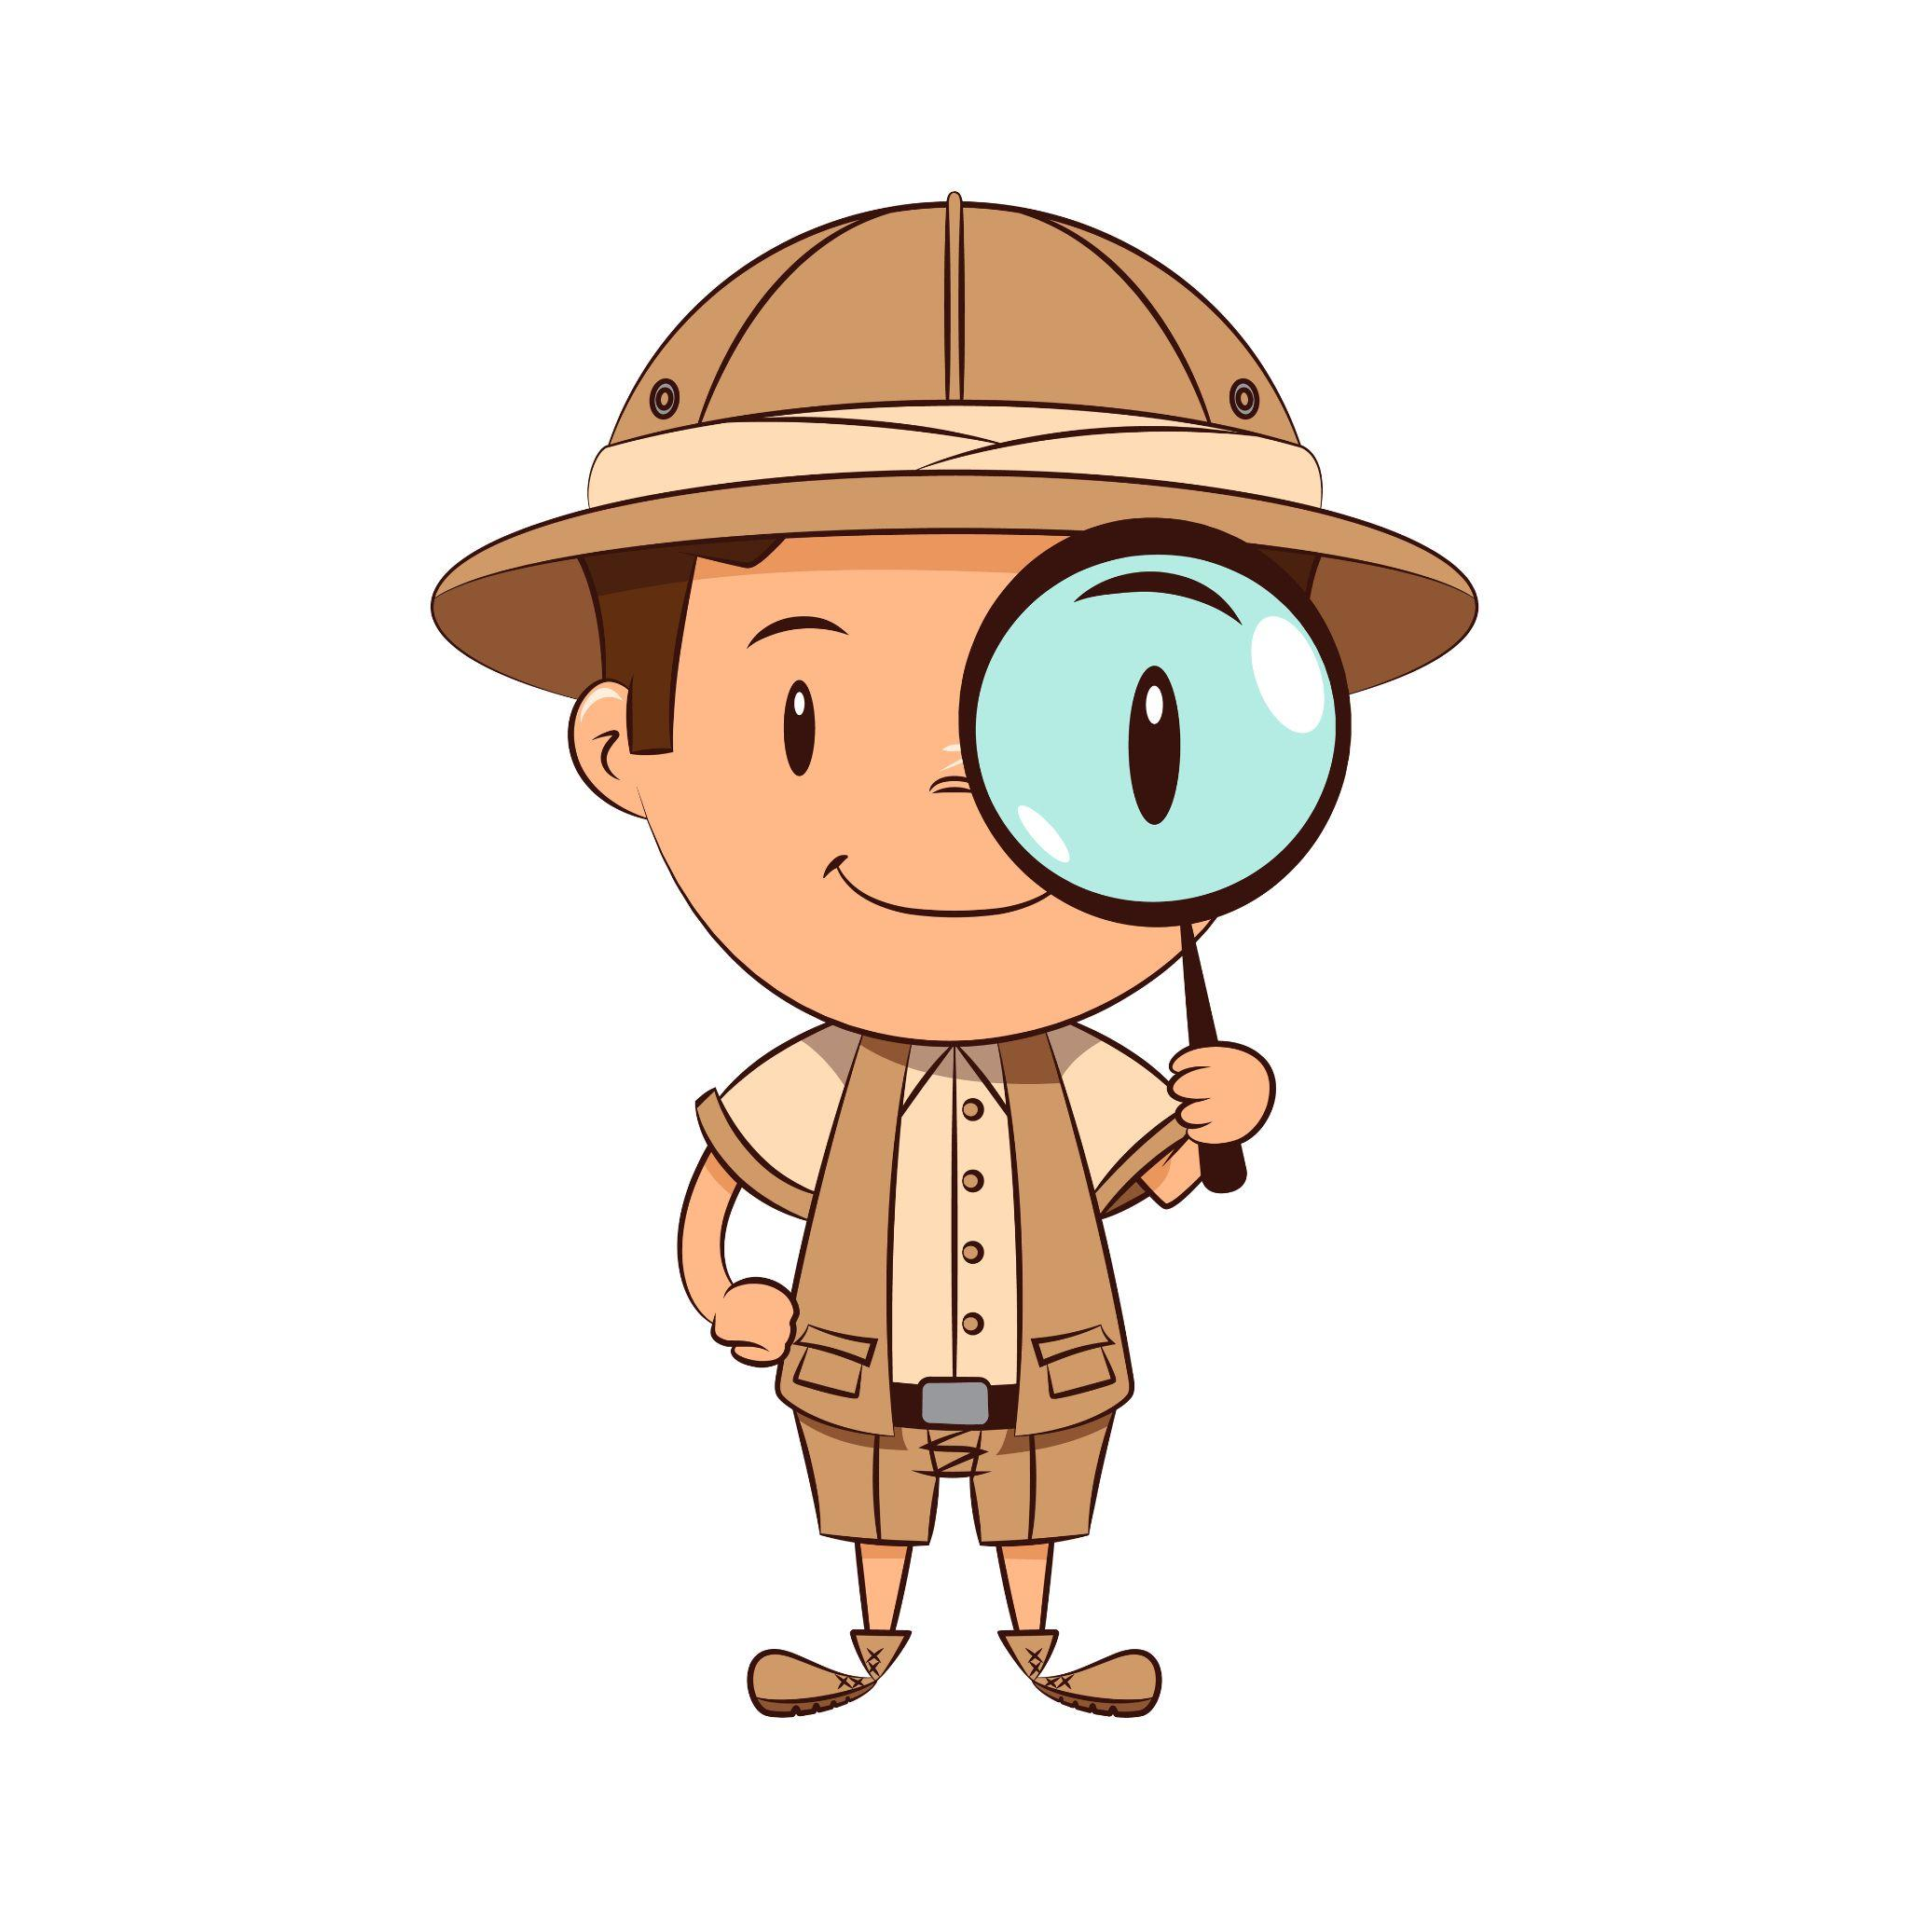
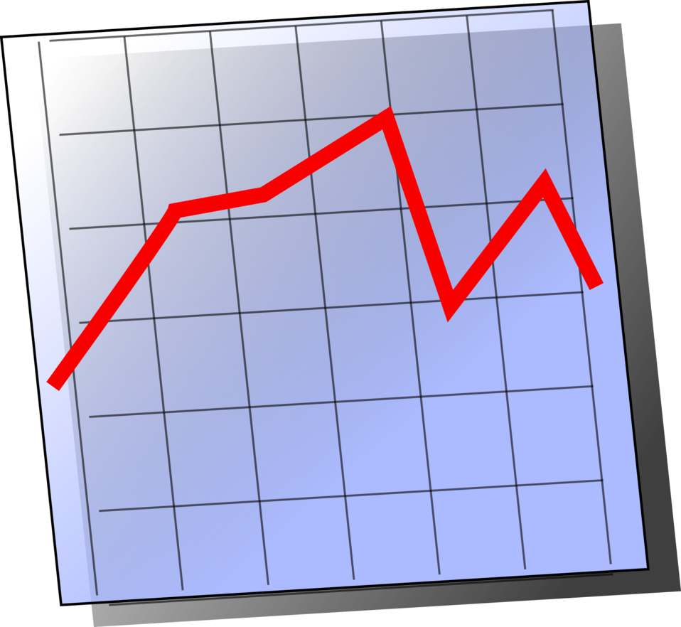

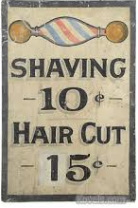
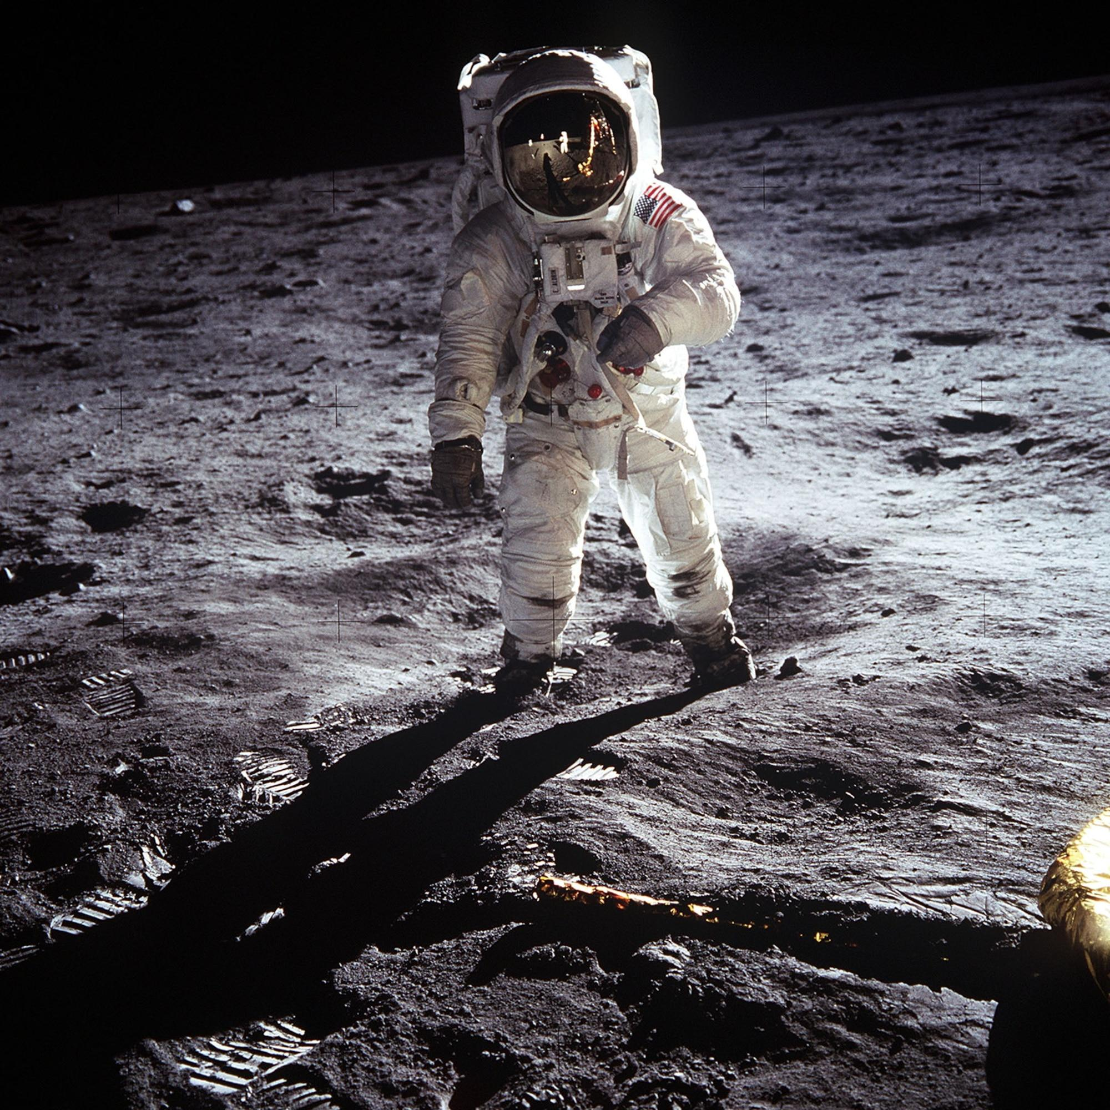

Chapter 1 Big Questions
PRE-READING CLASS DISCUSSION: How do we learn about the past?
People who WITNESSED an event (written or spoken accounts)
  Books, newspapers, magazines
  Records and data
  Pictures and video
  Objects left behind (artifacts)
  Art and music
  Architecture
  …and more!

Slide 6

Vocabulary

Slide 7

Chapter 1 Vocabulary
PRE-READING CLASS DISCUSSION: What do these mean?
Primary source
Secondary source
Evidence

Slide 8
Chapter 1 Vocabulary
Primary source: first hand accounts of a topic from people who have a direct connection with it
Secondary source: an account created later by someone who did not experience the subject first hand; they use primary sources to tell a bigger story about the subject
Evidence: proof that something is true

Slide 9
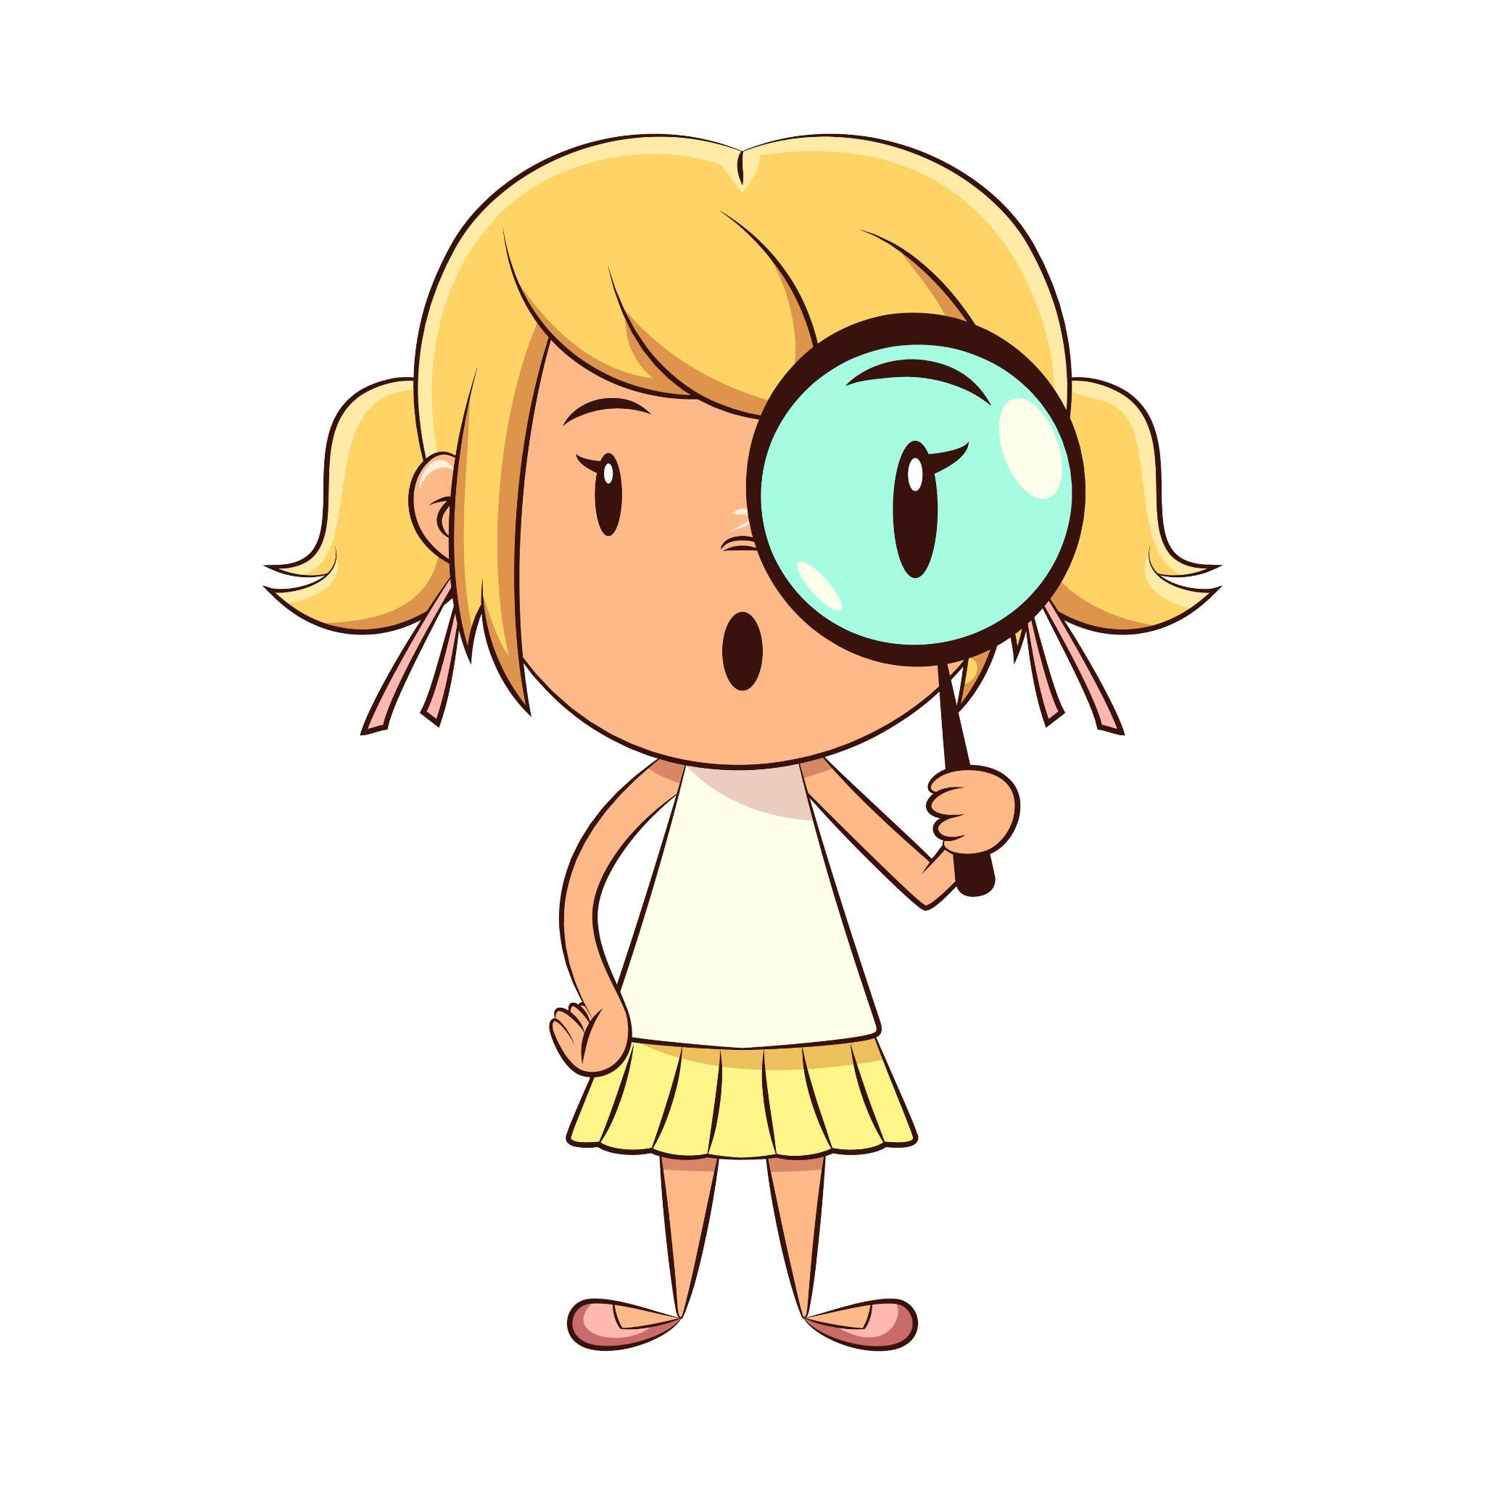
Characters

Slide 10

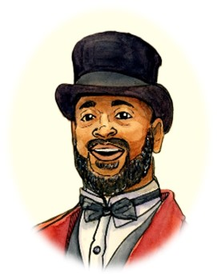
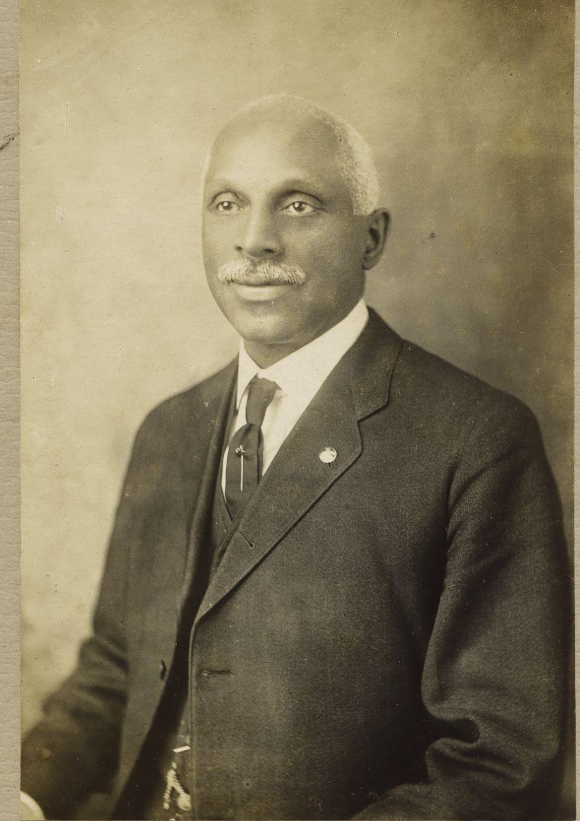
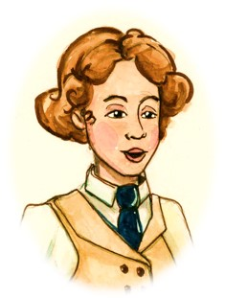
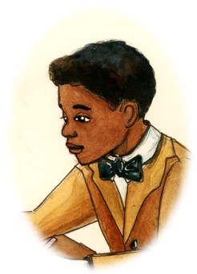
Chapter 1 Characters
Professor Ferguson
George Edwin Taylor
Williamina
Louis

Slide 11

Summary

Slide 12
Chapter 1 Summary
We are introduced to Professor Ferguson, Williamina, and Louis.
They begin their journey through history researching a man named George Edwin Taylor, the first African American to run for President.
Researchers admire a photo of George.
Researchers dig into a box of Primary Documents

Slide 13
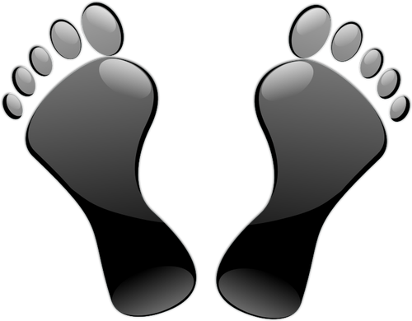
Step Away Activities

Slide 14
Chapter 1 Step Away Activities
Types of “Bad Evidence”
Unboxing History

Slide 15







Dr. Bruce Mouser and Family

Slide 16

