Slide 1
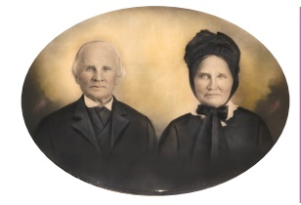
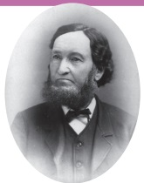
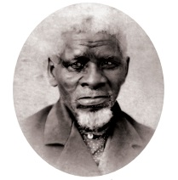
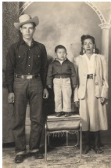
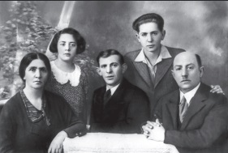
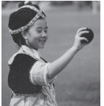
Coming to Wisconsin Project
Immigration and Settlement
Wisconsin State Historical Society

Slide 2
Learning Target/Objective
We will explore the reasons why people leave their homelands.
We will explore the reasons why people settled in Wisconsin.
We will analyze what immigrants’ lives were like in Wisconsin.

Slide 3
Instructions
Work in groups of 2-3.
Read Introduction to the Coming to Wisconsin article.
Groups select and read 1 section of the Coming to Wisconsin article.
This will be a “jigsaw” activity that analyzes the article as a whole
Look at the following slides for specific instructions for each section. Each group will be looking at
  main ideas
  specific questions related to their section
  defining vocabulary,
  researching pictures and maps to use on their poster.
Share-out findings and poster in a brief presentation.

Slide 4
Sections of Coming to Wisconsin Article
Introduction (everyone should read together)
1 - Immigration and Migration
2 - The Journey to Wisconsin
3 - Richard Thomas
4 - John Greene
5 - Koepsell Family
6 - Ketola Family
7 - Rosa Goldberg Katz
8 - Plata Family
9 - Mai Ya Xiong
10 - Wrap Up

Slide 5
Introduction Instructions
Read the Introduction, perhaps together as a class.
Highlight the map that shows Places of Settlement.
Highlight the timeline, especially the points that apply to the sections to be covered by groups.
Highlight the “Thinking Like a Historian” questions, and encourage students to apply those questions to the sections they cover to help organize their main ideas.

Slide 6
Section 1: Immigration and Migration
Summarize the main points of this section.
  Why did people leave their homes to move to Wisconsin?
  How did they travel?
  What were their lives like?
  Explain what push and pull factors are in relation to immigration.
Define vocabulary.
  Immigrant
  Immigration
  Migrant
  Migration
  Ethnic
  Heritage
Research and include some pictures and maps that illustrate main points and vocabulary.

Slide 7
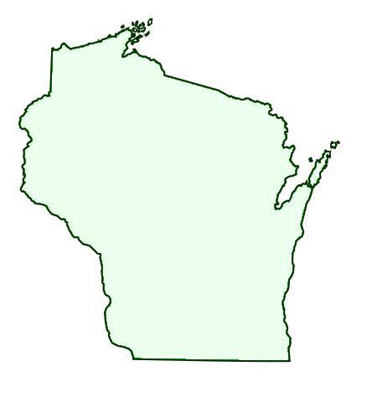
Section 2: The Journey to Wisconsin
Summarize the main points of this section.
  How did people travel to Wisconsin?
  What were some important turning points in travel?
Define vocabulary.
  Invention
  Emigrate
Research and include some pictures and maps that illustrate main points and vocabulary.

Slide 8
Section 3: Richard Thomas
Summarize the main points of this section.
  Who was Richard Thomas?
  Why did he choose to leave his homeland?
  Where did he settle?
  What was his life like in Wisconsin?
Define vocabulary.
  Copper
  Stonemason
  Apprentice
  Quarried
  Widower
  Mansion
  Obituary
Research and include some pictures and maps that illustrate main points and vocabulary.

Slide 9
Section 4: John Greene
Summarize the main points of this section.
  What led John Greene to Wisconsin?
  What was it like to be a slave?
  Where did John Greene live in Wisconsin?
  Why did people emigrate to Pleasant Ridge?
  What was the role of churches and schools? What were they like?
Define vocabulary.
  Slave
  Civil War
  Integrated
Research and include some pictures and maps that illustrate main points and vocabulary.

Slide 10
Section 5: Koepsell Family
Summarize the main points of this section.
  Why did the Koepsells leave their homeland?
  Where and why did they settle in Wisconsin?
  What was life like in Wisconsin for the Koepsells?
Define vocabulary.
  Religious freedom
  Dairy cows
Research and include some pictures and maps that illustrate main points and vocabulary.

Slide 11

Section 6: Ketola Family
Summarize the main points of this section.
  Why did Heikki Ketola and his family leave their homeland?
  Where and why did they settle in Wisconsin?
  What was the process to bring the rest of his family to Wisconsin?
  What was it like living in Wisconsin?
Define vocabulary.
  Homestead
  Deed
  Root cellar
  Rutabagas
  Equipment
Research and include some pictures and maps that illustrate main points and vocabulary.

Slide 12
Section 7: Rosa Goldberg Katz
Summarize the main points of this section.
  What was the Holocaust?
  What were some methods the Nazis used?
  How did Rosa Goldberg Katz survive the Holocaust?
  Why did Rosa and her husband come to Wisconsin?
  What was life like in Oshkosh, Wisconsin?
Define vocabulary.
  Invaded
  Ghetto
  Concentration camps
  Synagogue
  Oral historian
Research and include some pictures and maps that illustrate main points and vocabulary.

Slide 13
Section 8: Plata Family
Summarize the main points of this section.
  Who is Cris Plata?
  What was the Plata family life like?
  What was it like to be migrant workers in Wisconsin?
  Why did the Plata family choose Wisconsin to be their home?
Define vocabulary.
  Migrating
  Livestock
  Migrant workers
  Combine
  Veterinary school
  Veterinarian
Research and include some pictures and maps that illustrate main points and vocabulary.

Slide 14
Section 9: Mai Ya Xiong
Summarize the main points of this section.
  Who is Mai Ya Xiong? Where is she and her family from?
  Why did Mai Ya’s family leave their home?
  What was the Vietnam War?
  What was life like for Mai Ya’s family in Wisconsin?
Define vocabulary.
  Hmong
  Refugee camp
  Sponsor
Research and include some pictures and maps that illustrate main points and vocabulary.

Slide 15
Section 10: Wrap Up
Summarize the main points of this section.
  What are push factors? What are some examples?
  What are pull factors? What are some examples?
  What are some reasons people immigrated to Wisconsin?
Define vocabulary.
  Push factor
  Pull factor
Research and include some pictures and maps that illustrate main points and vocabulary.
  Create a map of the places listed under “Some Places to Visit” using a blank map of Wisconsin

Slide 16
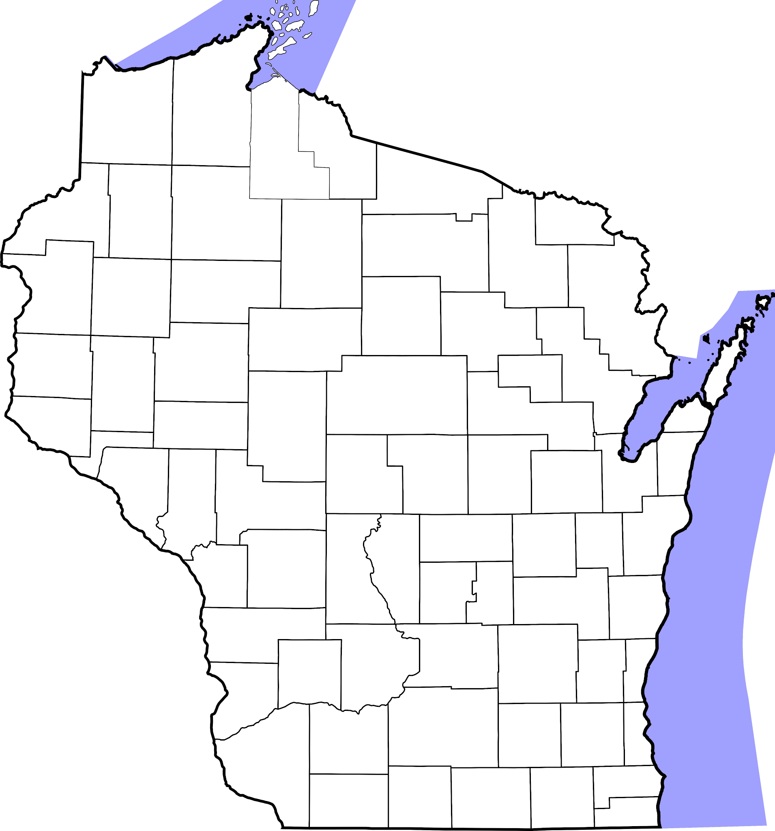
Section 10 Group: Use this template for your map.

Slide 17







American Association of University Women

Slide 18

